Slide 1
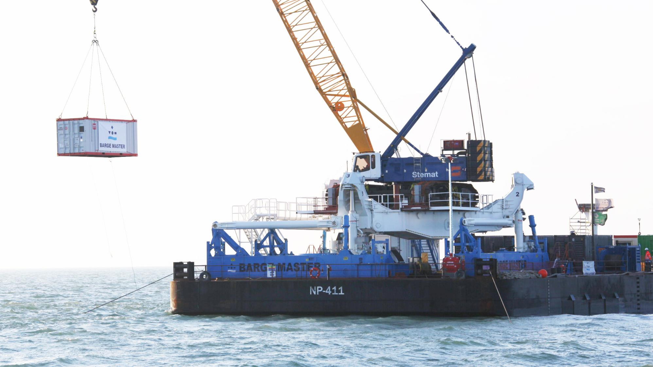
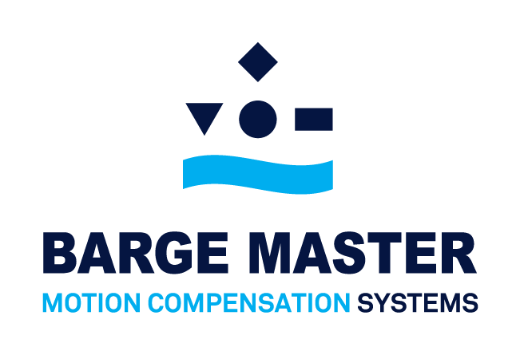

Slide 2
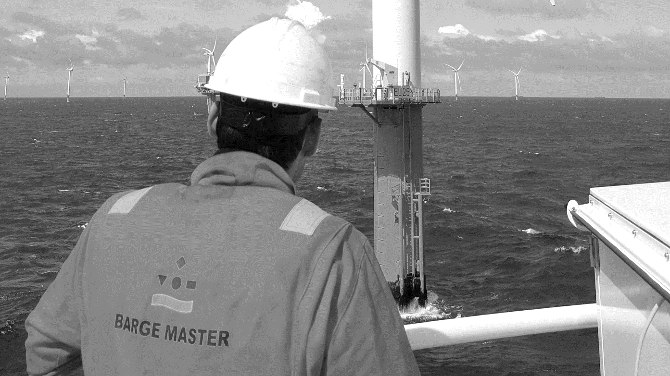

BARGE MASTER
COMPANY

Slide 3
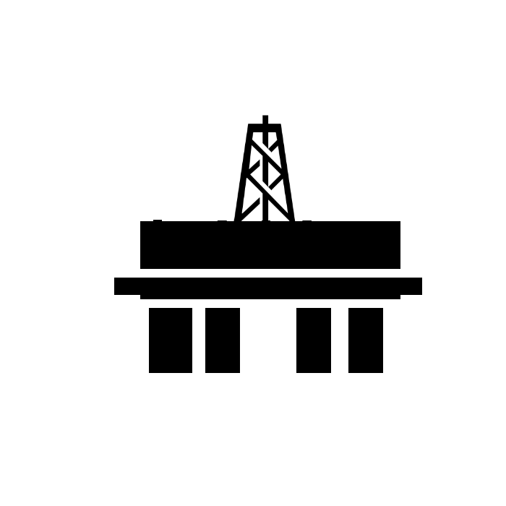
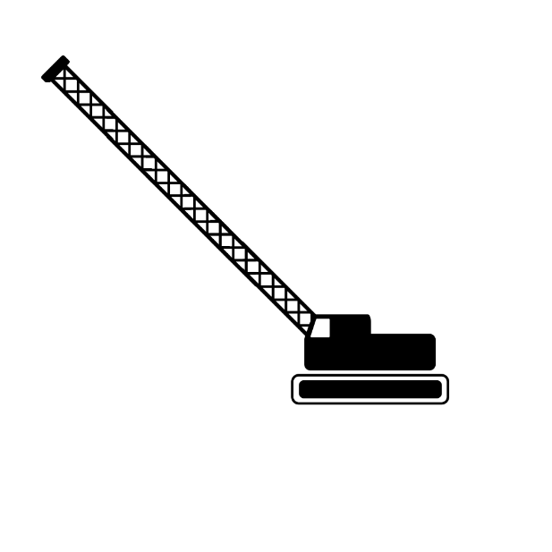
BARGE MASTER SOLUTIONS
INCREASING WORKABILITY

Slide 4
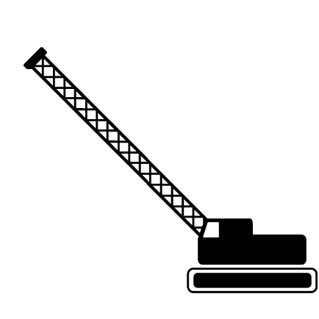
BARGE MASTER SOLUTIONS
INCREASING WORKABILITY
BM-T700

Slide 5
BARGE MASTER SOLUTIONS
INCREASING WORKABILITY

Slide 6
BARGE MASTER SOLUTIONS
INCREASING WORKABILITY
CLICK TO PLAY COMPANY MOVIE ON YOUTUBE

Slide 7
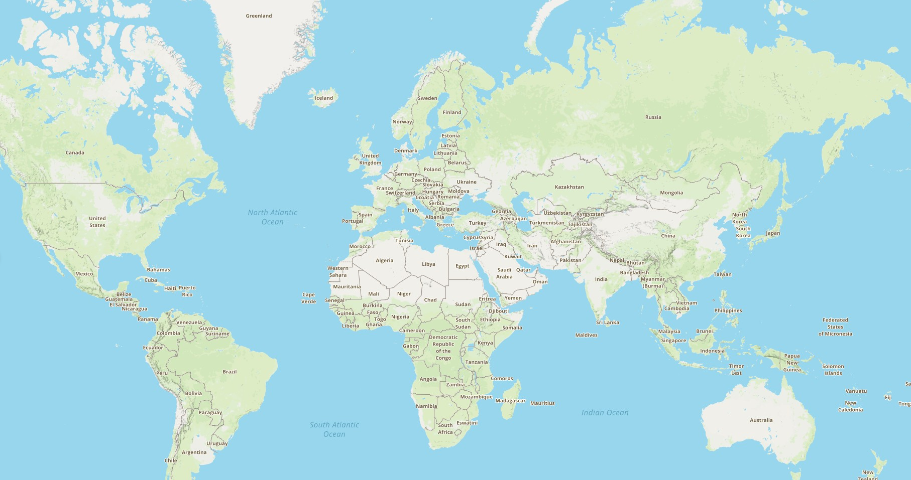
BARGE MASTER SOLUTIONS
GLOBAL COVERAGE
Worldwide coverage
Founded in 2008, Rotterdam the Netherlands
All products build in the Netherlands
Rental and sale, certified by DNV or Lloyds
Growth trough partnerships with agents, clients and suppliers
Ambition to become te solution for waiting on weather

Slide 8
BARGE MASTER SOLUTIONS
GLOBAL PROJECTS

Slide 9
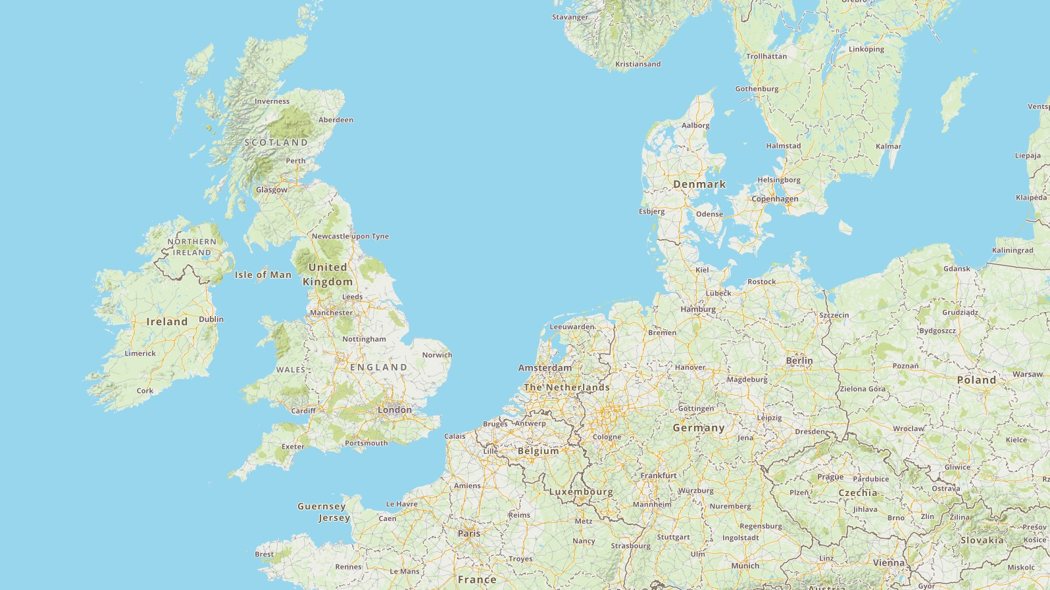
BARGE MASTER SOLUTIONS
EU PROJECTS

Slide 10
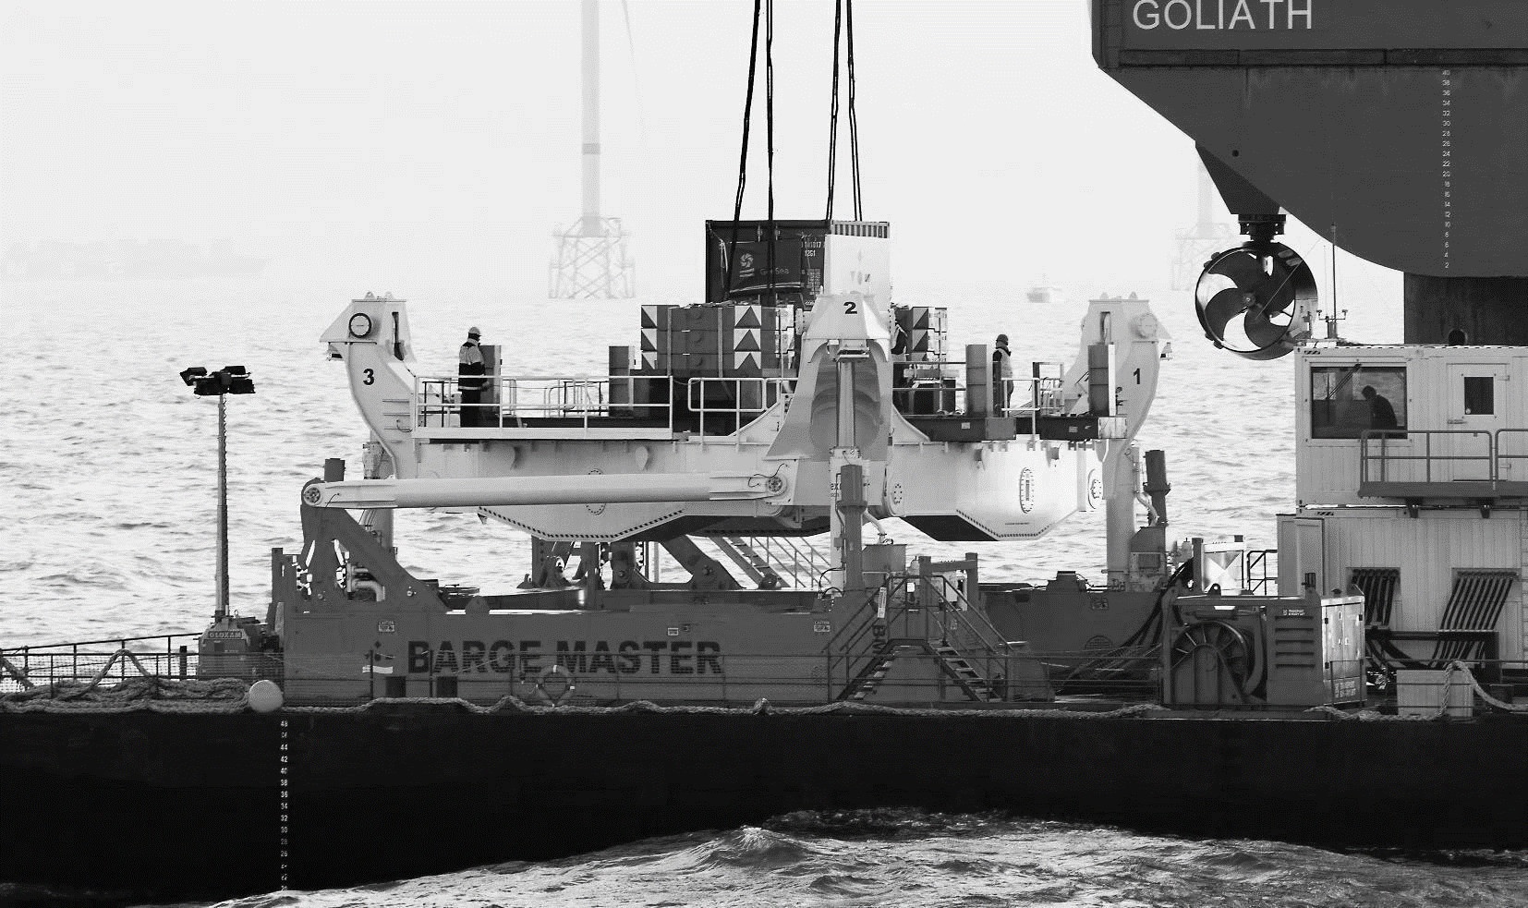
MOTION COMPENSATED PLATFORM

Slide 11
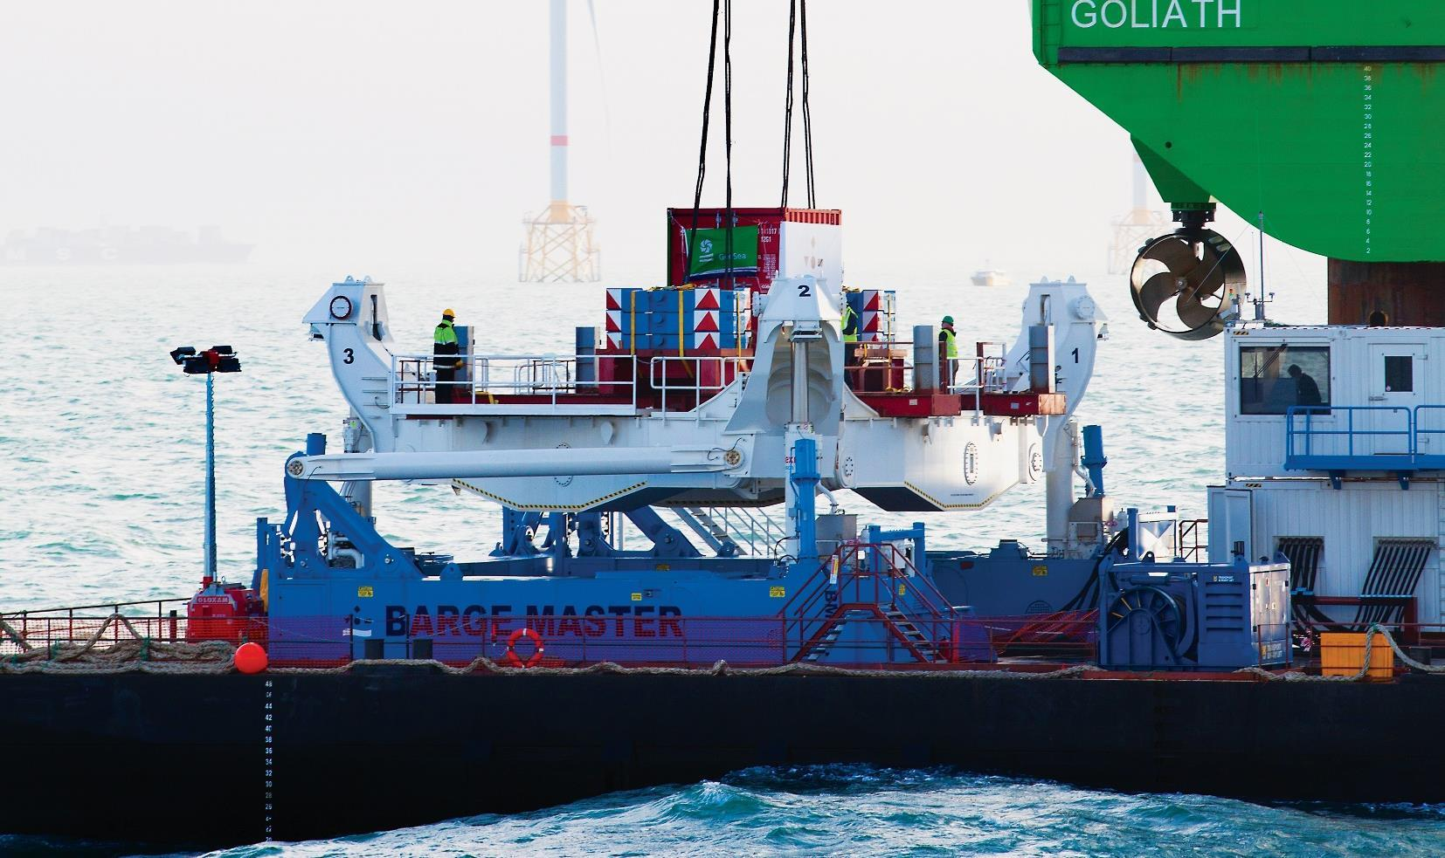
BARGE MASTER SOLUTIONS
MOTION COMPENSATED PLATFORM

Slide 12





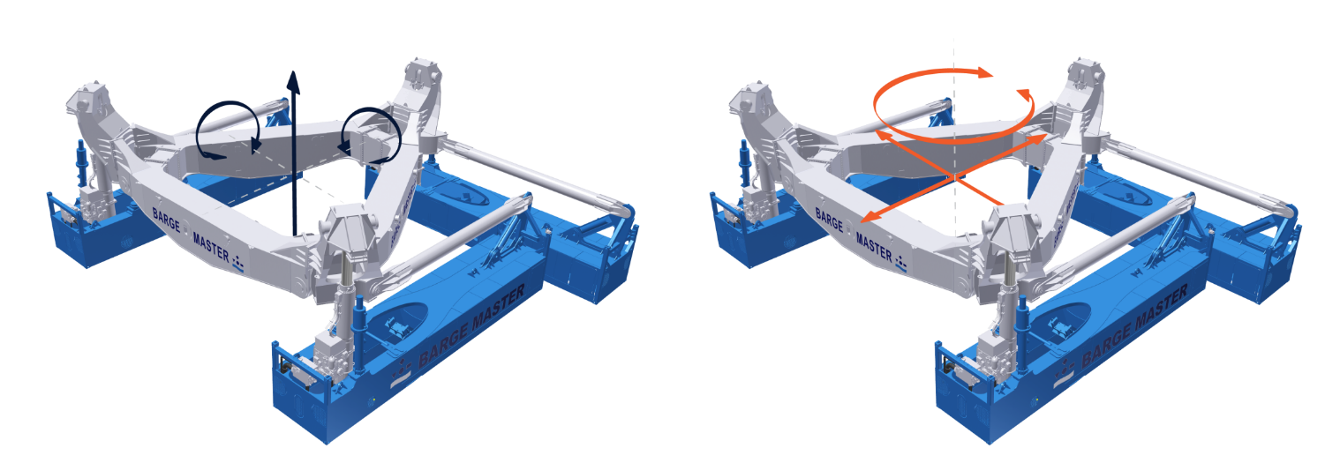
BARGE MASTER SOLUTIONS
MOTION COMPENSATED PLATFORM
Compensation up to Hs 2,5 m.
18,3 m. x 15,1 m.
Capacity 700 mT
270 mT
Lloyds register certified
Compensation of Heave,
Roll and Pitch motion
Fixation of Surge, Sway and Yaw

Slide 13
BARGE MASTER SOLUTIONS
MOTION COMPENSATED PLATFORM
CLICK TO PLAY COMPANY MOVIE ON YOUTUBE

Slide 14
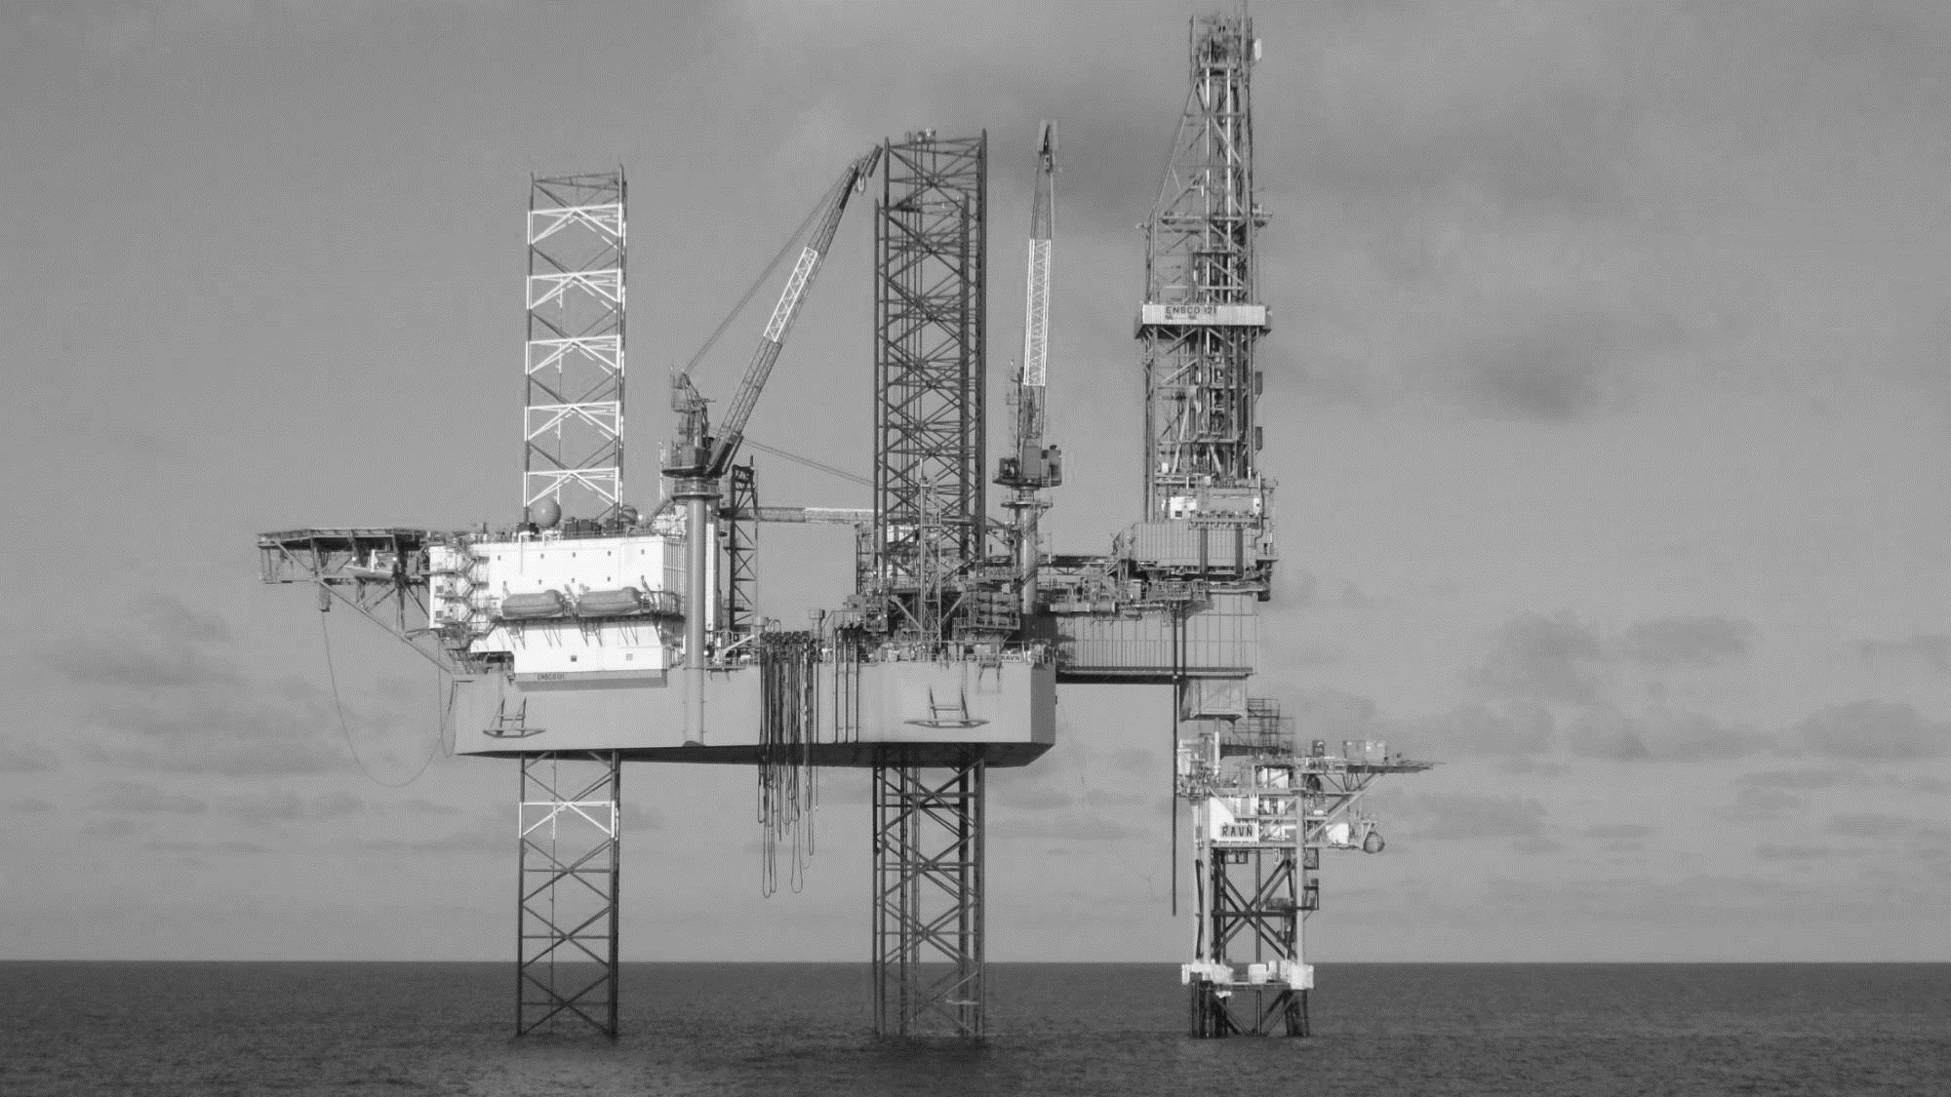
WELL
INTERVENTION

Slide 15
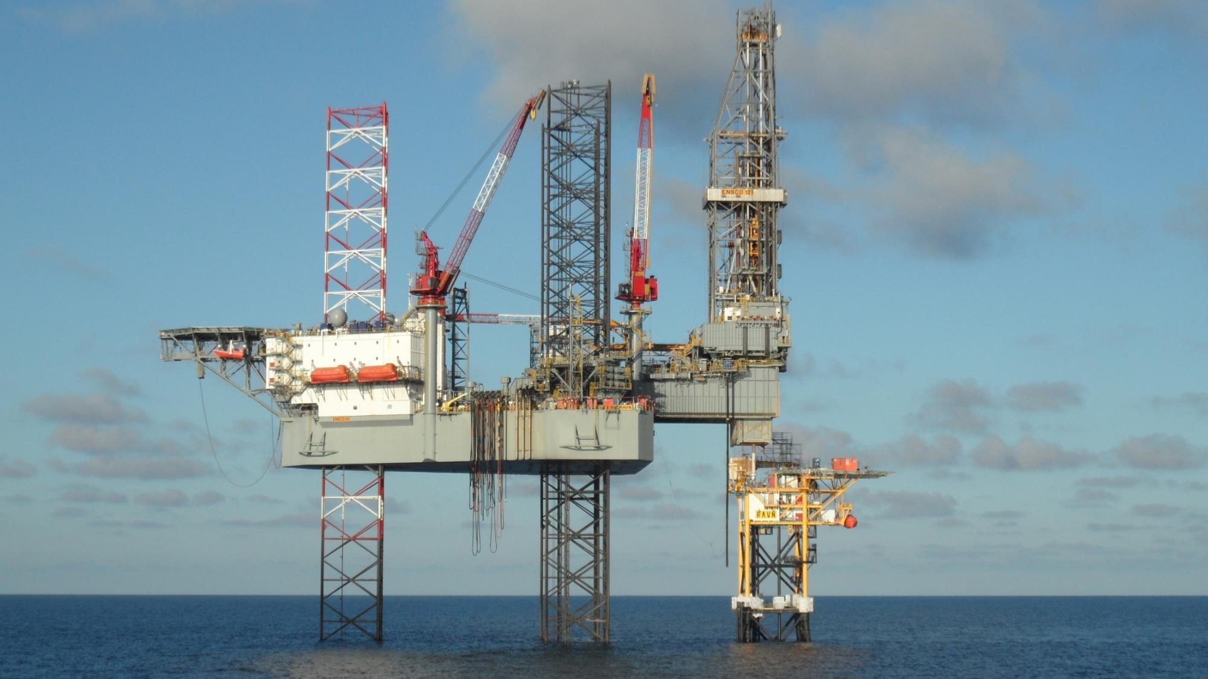
WELL INTERVENTION
CONVENTIONAL METHODS

Slide 16
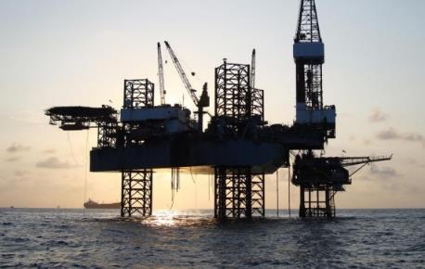
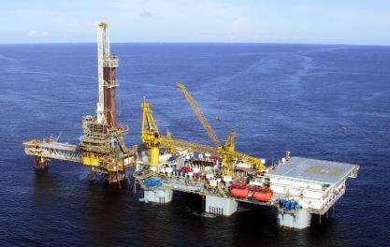
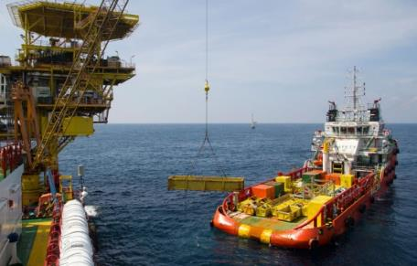
WELL INTERVENTION
CONVENTIONAL METHODS
Jackup rigs with cantilever rig
(semisubmersible) Tender Barges
with offshore crane
These are limited by wave height and cause unsafe working conditions.
Transfer Well Workover equipment onto platform, using platform supply vessel (PSV)
Limited by wave height, deck space, accommodation space and each offshore facility needs its own platform crane.
These are expensive to mobilize, hard to maneuver and limited by water depth and soil conditions/obstructions.
HIGH COST &
LIMITED WORKABILITY

Slide 17
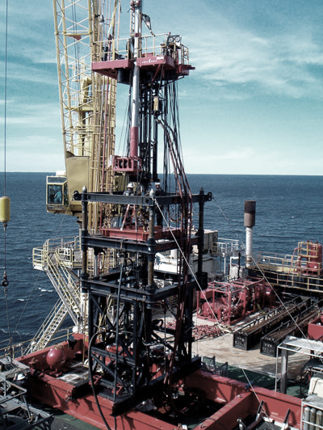
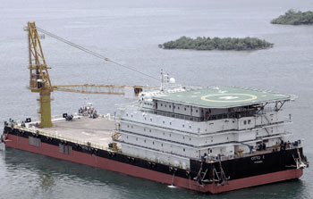
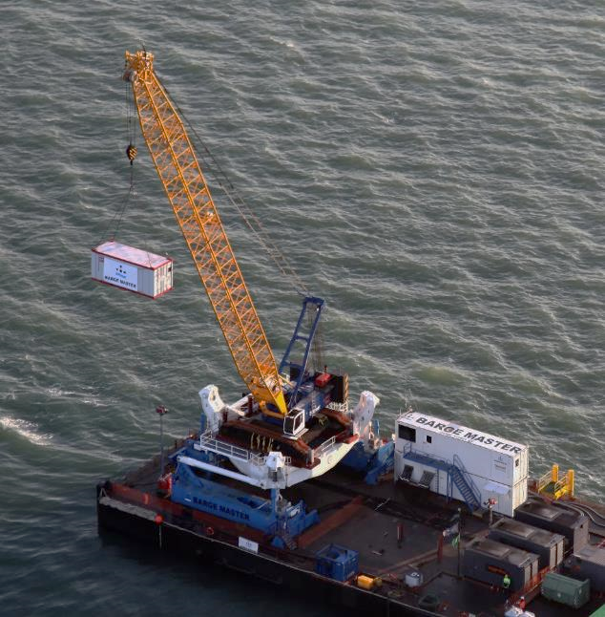
WELL INTERVENTION
BARGE MASTER SOLUTION
+
Hydraulic Workover Unit
Accommodation barge
BM-T700 Motion compensation platform

Slide 18
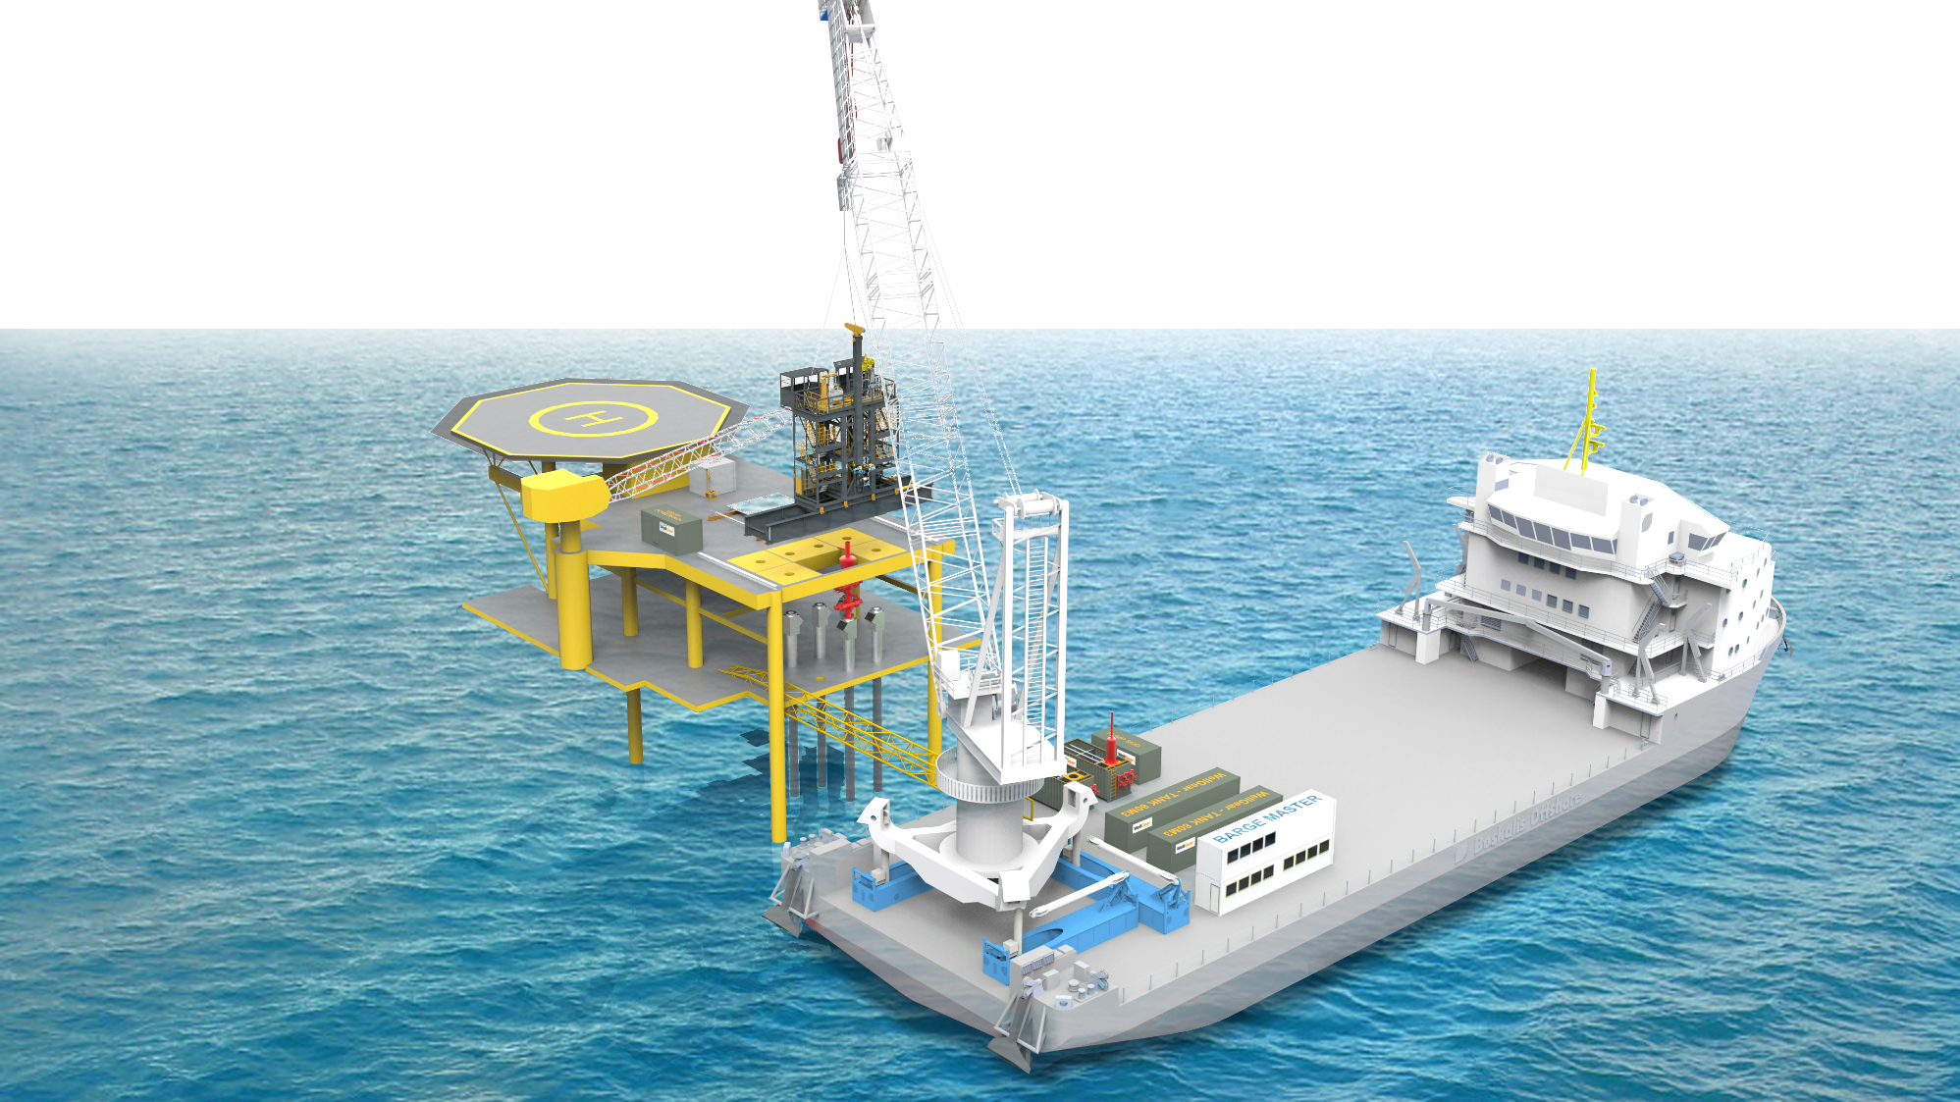
WELL INTERVENTION
BARGE MASTER SOLUTION
Lifting up to 150 ton

Slide 19
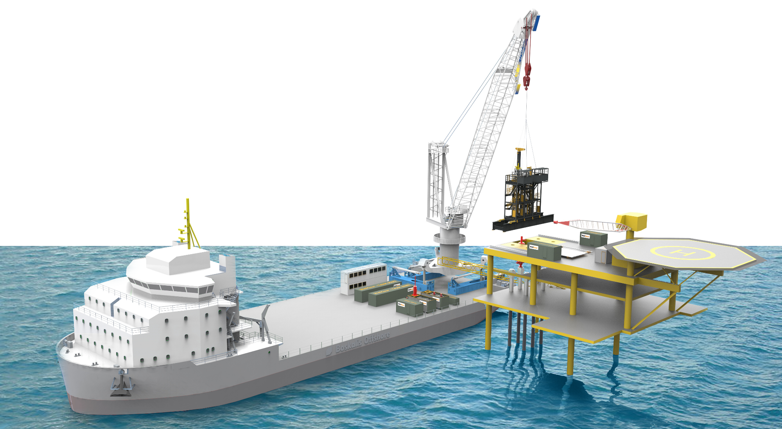
WELL INTERVENTION
SAFE LIFTING OF EQUIPMENT
Low cost system
Unlocking intervention work

Slide 20
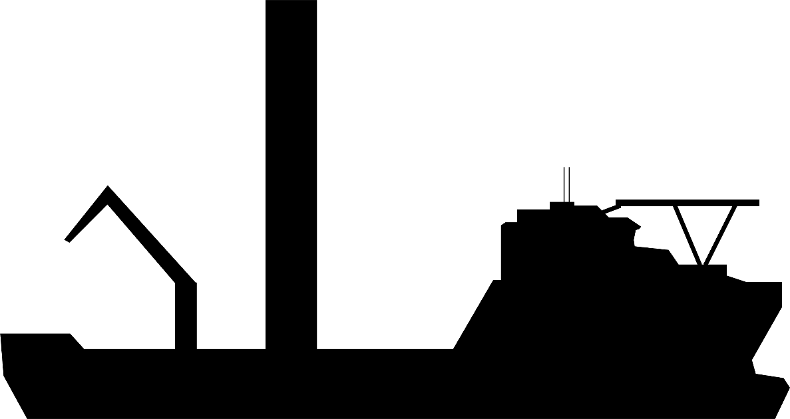
WELL INTERVENTION
MOTION COMPENSATION

Slide 21
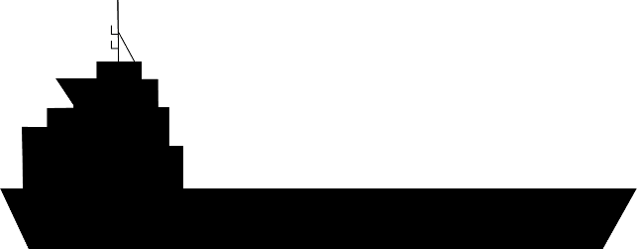

WELL INTERVENTION
MOTION COMPENSATION
BM-T700

Slide 22
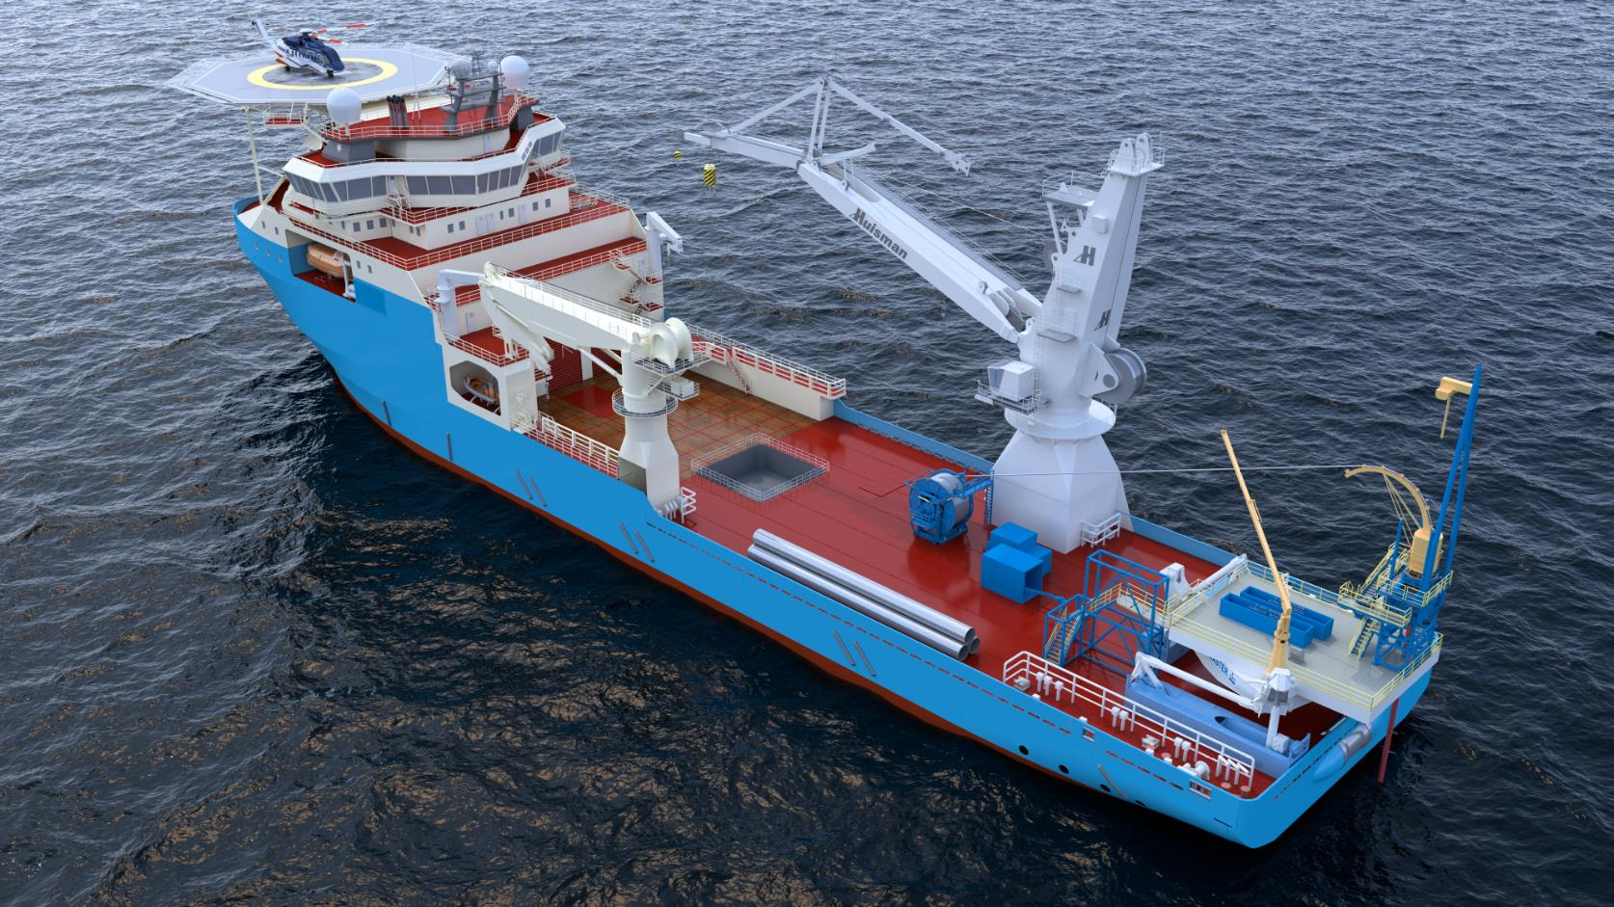
WELL INTERVENTION
COILED TUBING

Slide 23
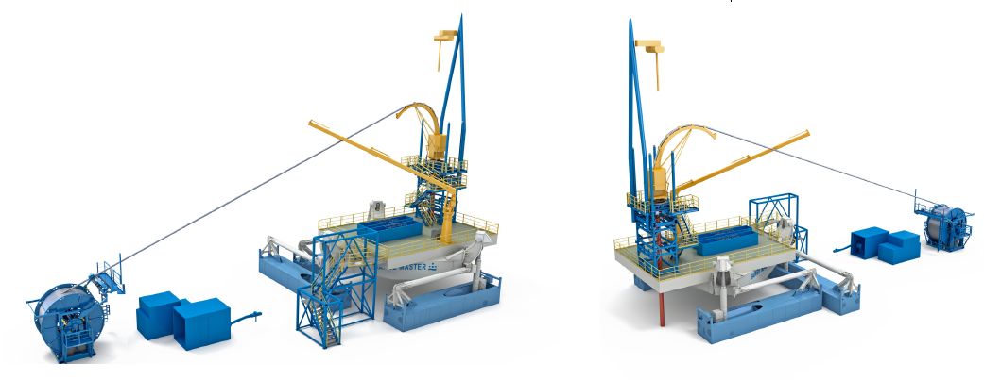
WELL INTERVENTION
COILED TUBING
Payload Capacity: 700mT
Offshore crane capabilities
Working platform 12x12m
Multi purpose:
    Coiled Tubing
    Wireline
    Slickline
    Drilling
    Etc.

Slide 24
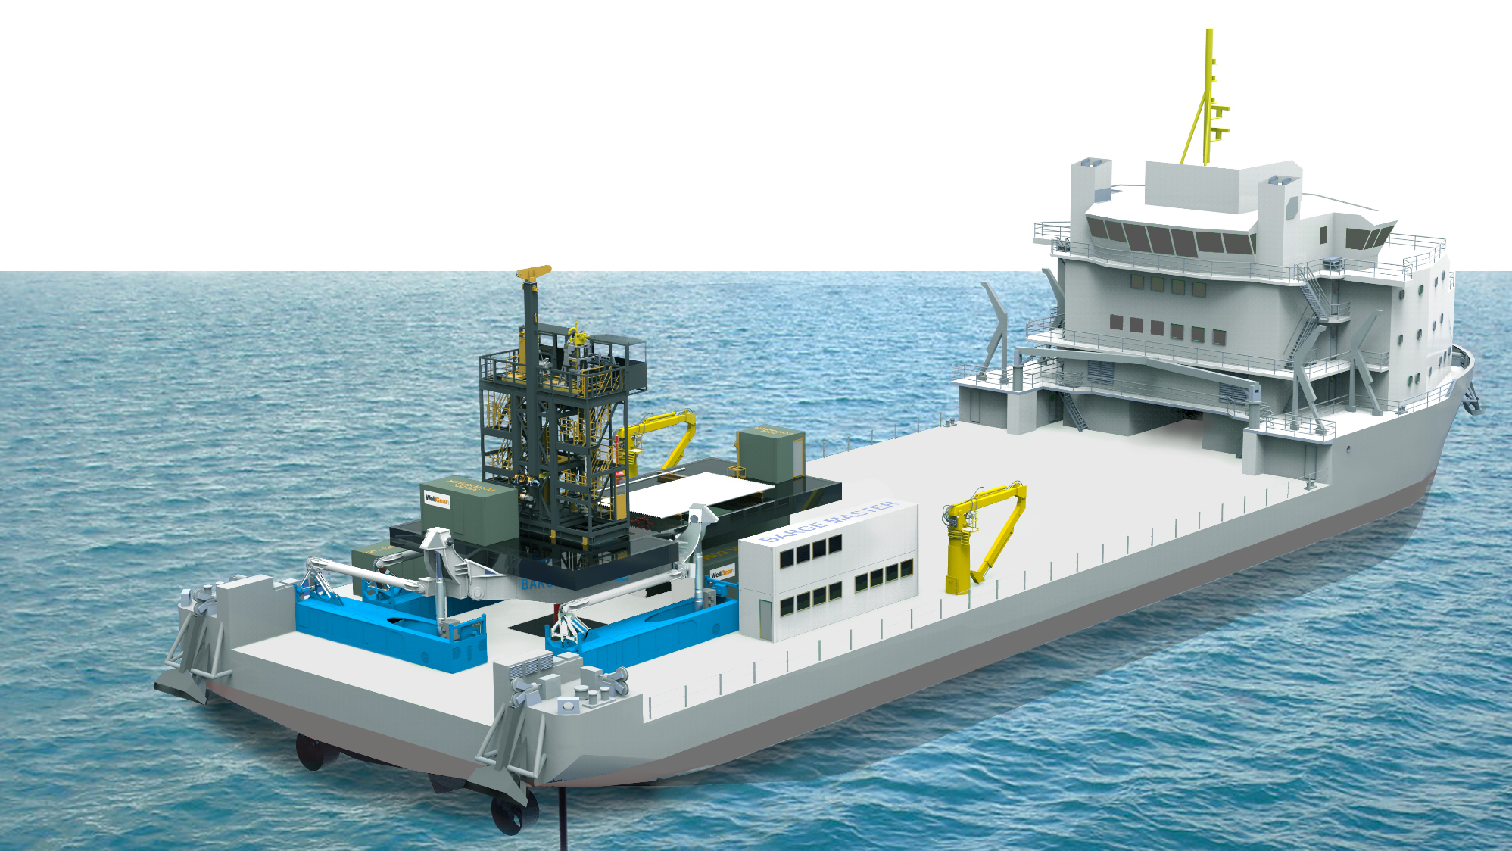
WELL INTERVENTION
BM SOLUTION

Slide 25
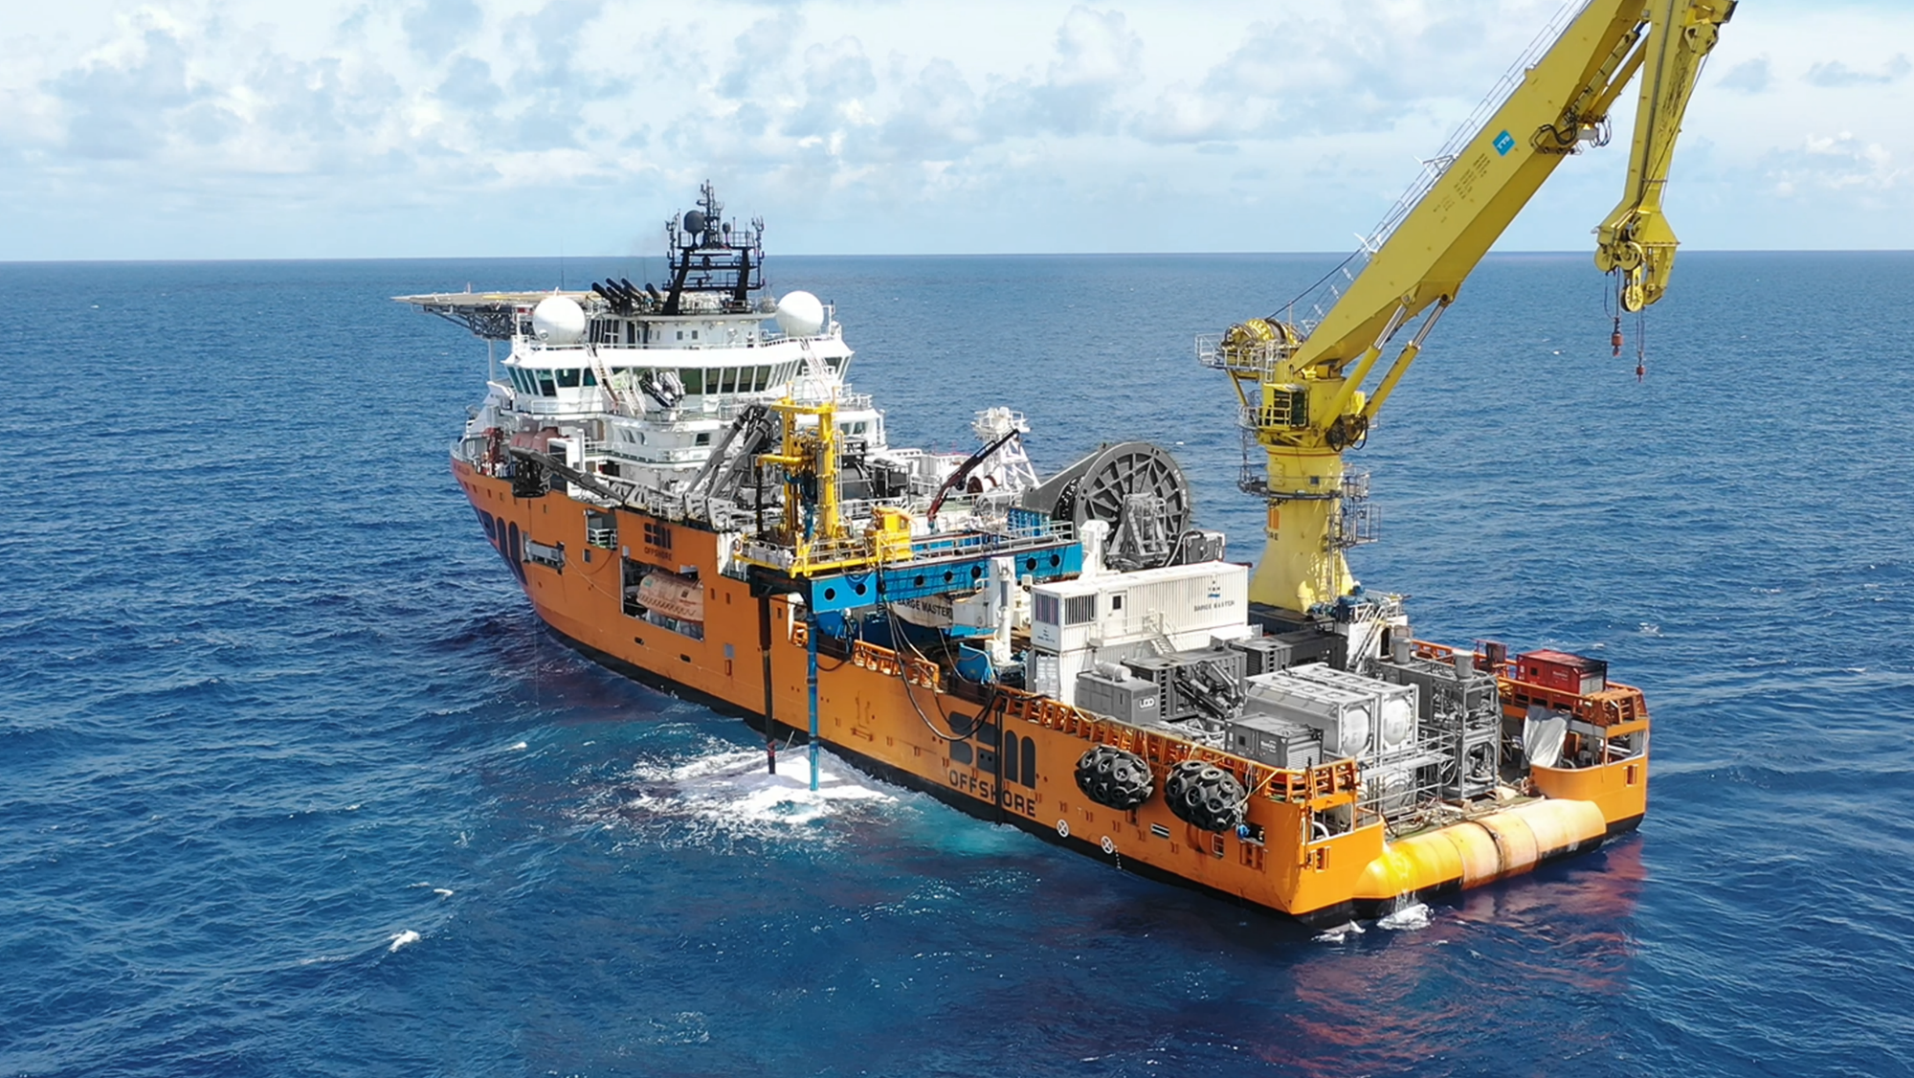
WELL INTERVENTION
PROVEN TECHNOLOGY

Slide 26
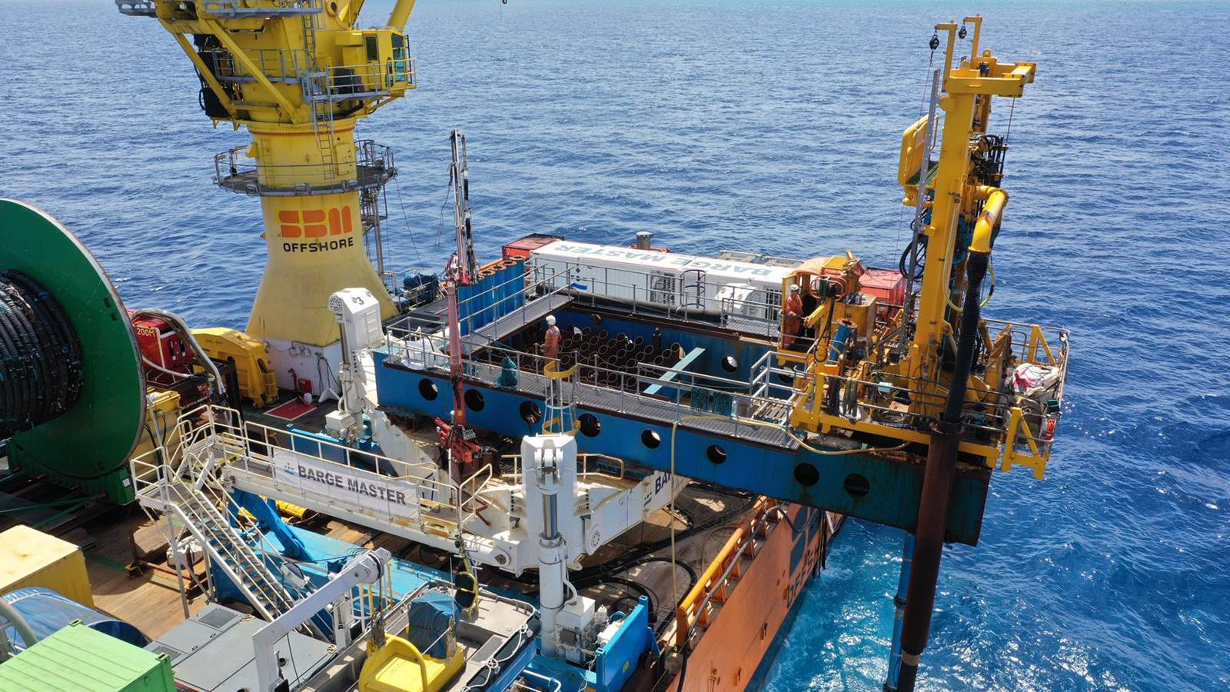
WELL INTERVENTION
PROVEN TECHNOLOGY

Slide 27
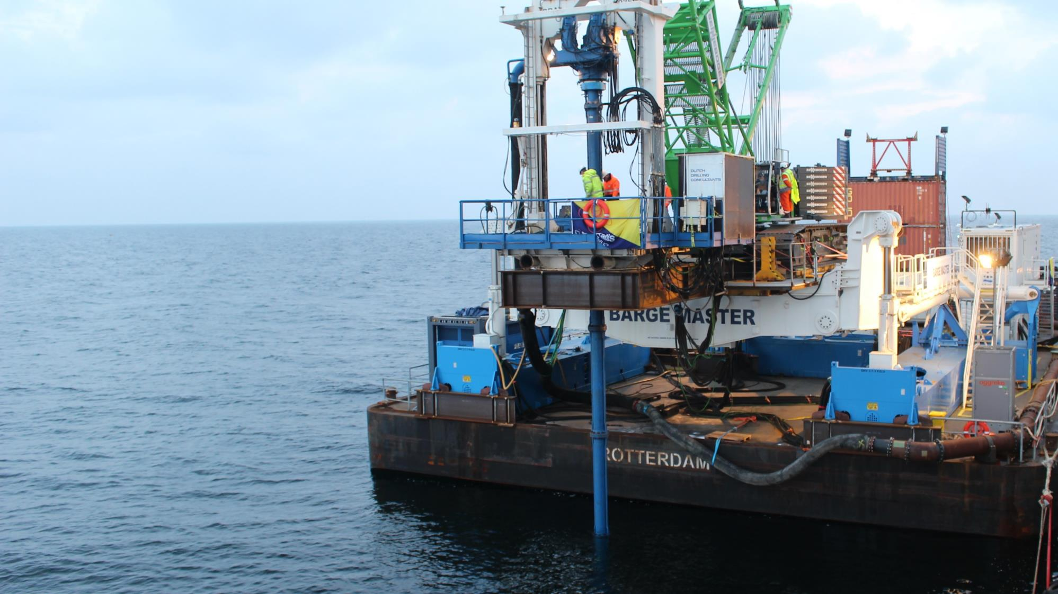
WELL INTERVENTION
PROVEN TECHNOLOGY

Slide 28
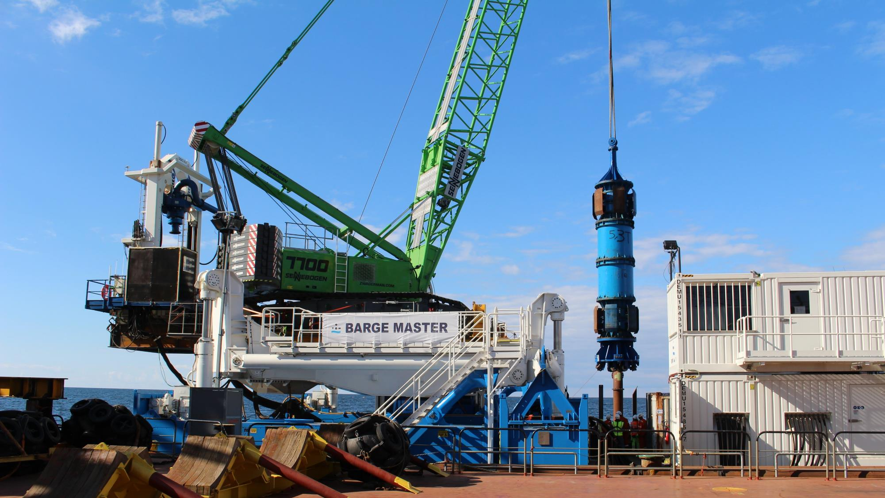
WELL INTERVENTION
PROVEN TECHNOLOGY

Slide 29
WELL INTERVENTION
PROVEN TECHNOLOGY
CLICK TO PLAY COMPANY MOVIE ON YOUTUBE

Slide 30
