Slide 1
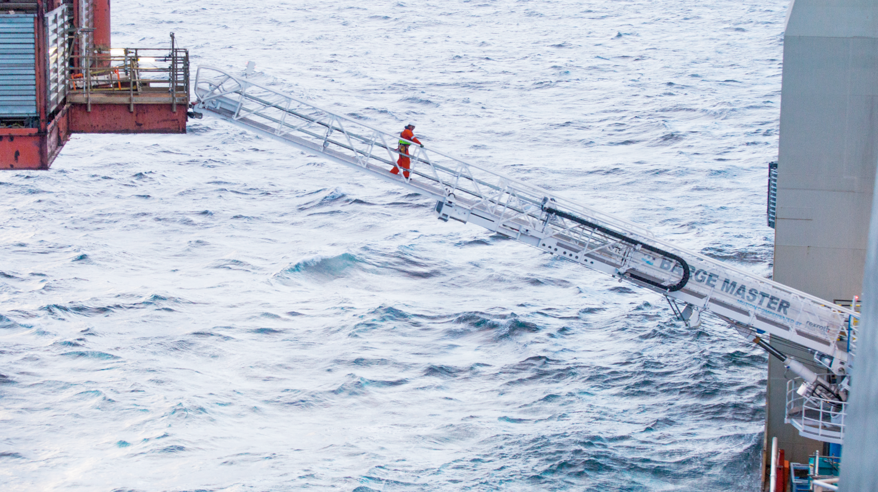
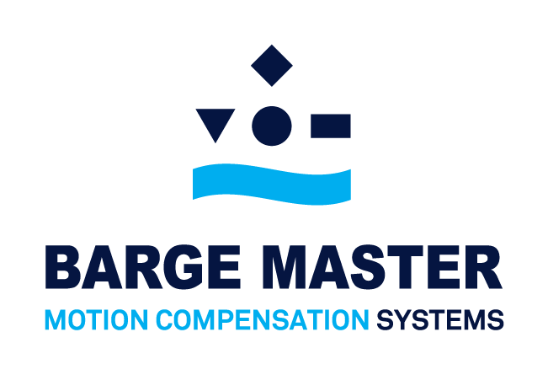

Slide 2

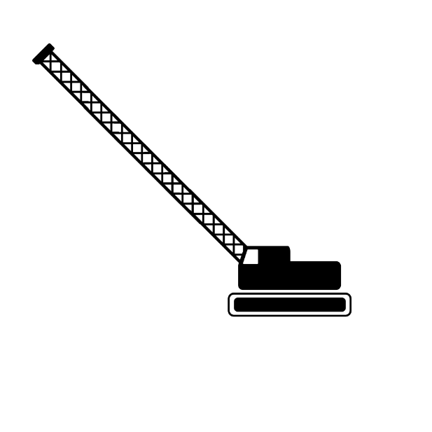

BARGE MASTER SOLUTIONS
INCREASING WORKABILITY

Slide 3
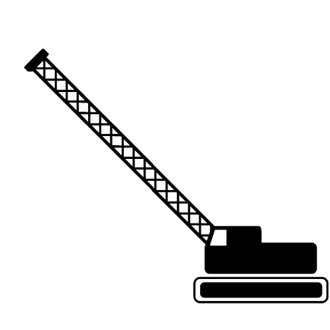
BARGE MASTER SOLUTIONS
INCREASING WORKABILITY
BM-T700

Slide 4
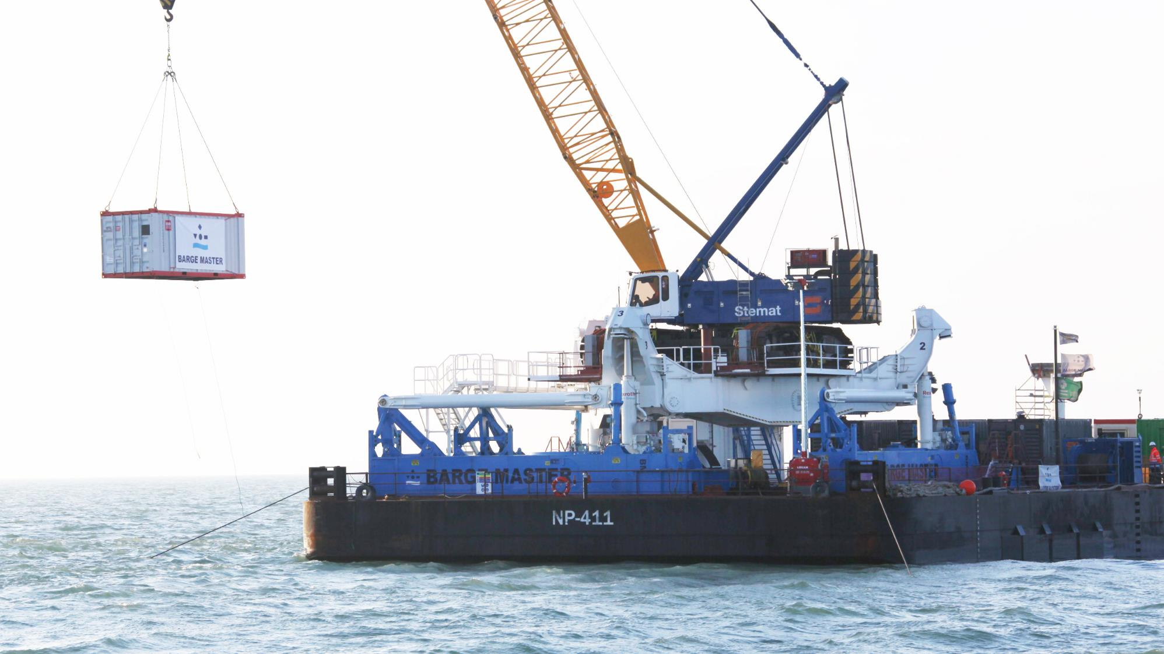
BARGE MASTER SOLUTIONS
INCREASING WORKABILITY

Slide 5
BARGE MASTER SOLUTIONS
INCREASING WORKABILITY
CLICK TO PLAY COMPANY MOVIE ON YOUTUBE

Slide 6
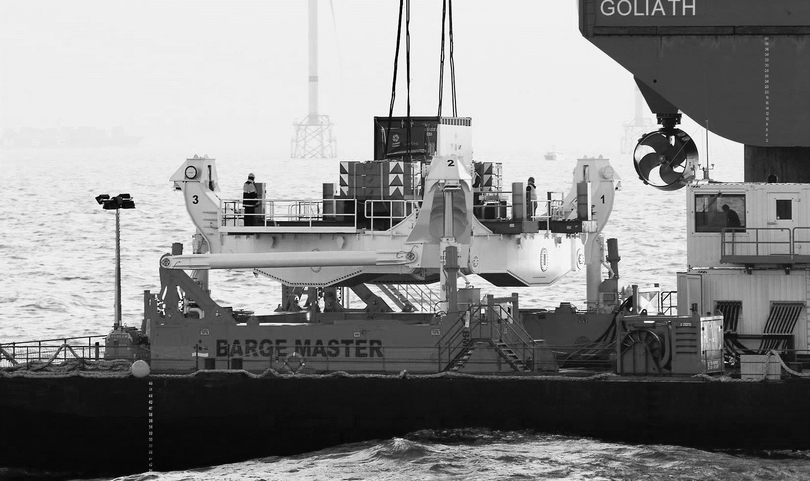
MOTION COMPENSATED PLATFORM

Slide 7
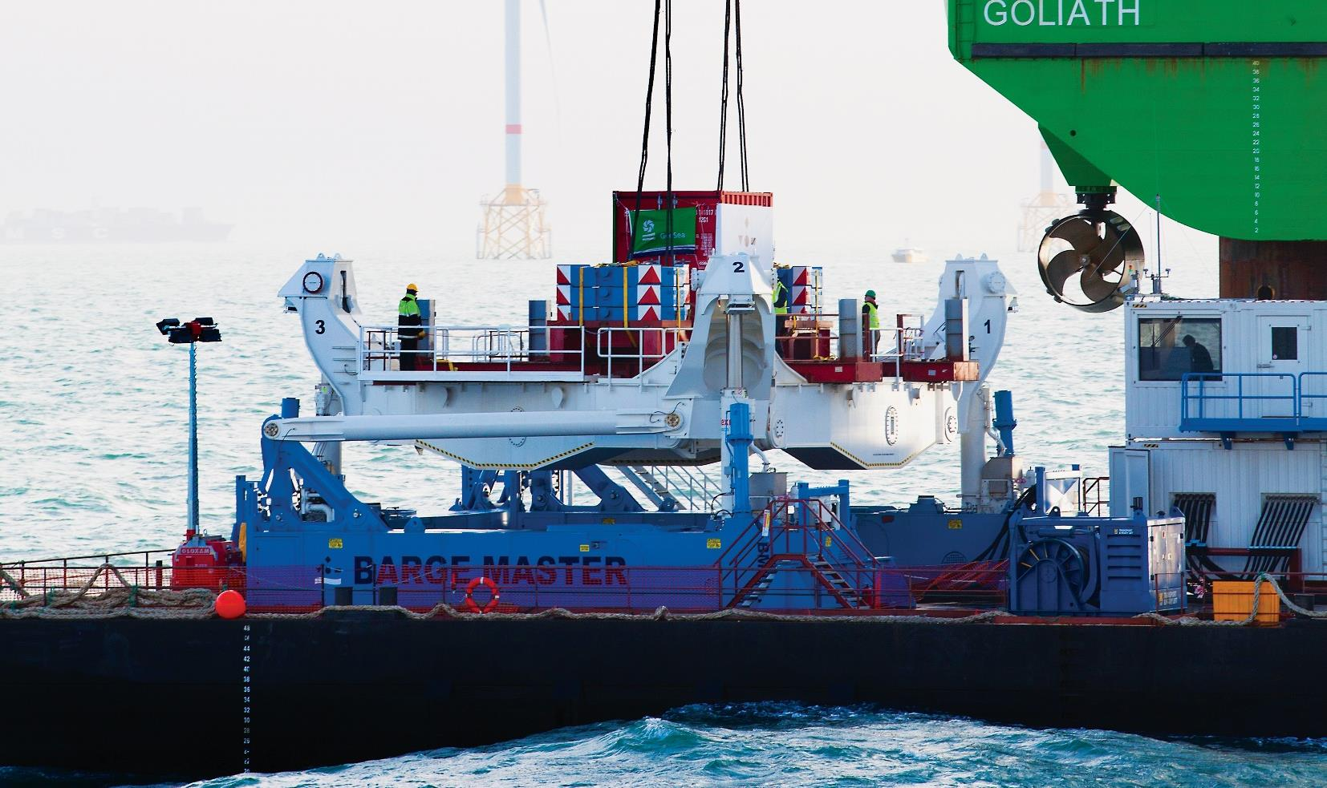
BARGE MASTER SOLUTIONS
MOTION COMPENSATED PLATFORM

Slide 8





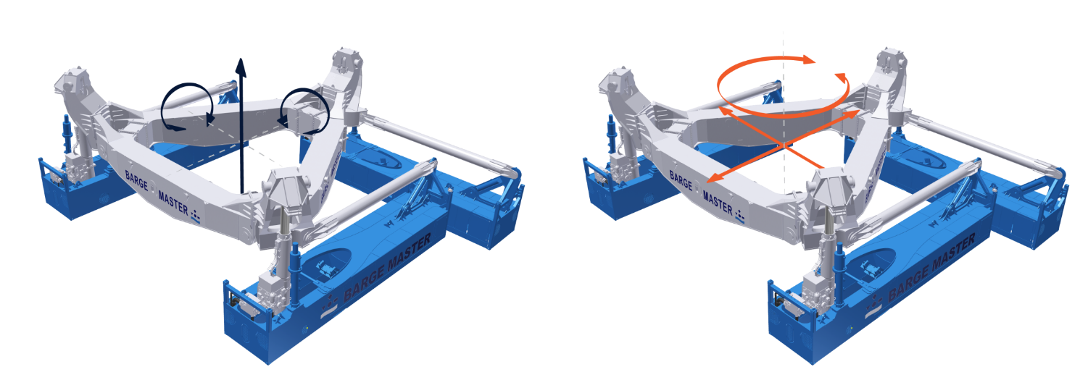
BARGE MASTER SOLUTIONS
MOTION COMPENSATED PLATFORM
Compensation up to Hs 2,5 m.
18,3 m. x 15,1 m.
Capacity 700 mT
270 mT
Lloyds register certified
Compensation of Heave,
Roll and Pitch motion
Fixation of Surge, Sway and Yaw

Slide 9
BARGE MASTER SOLUTIONS
MOTION COMPENSATED PLATFORM
CLICK TO PLAY COMPANY MOVIE ON YOUTUBE

Slide 10
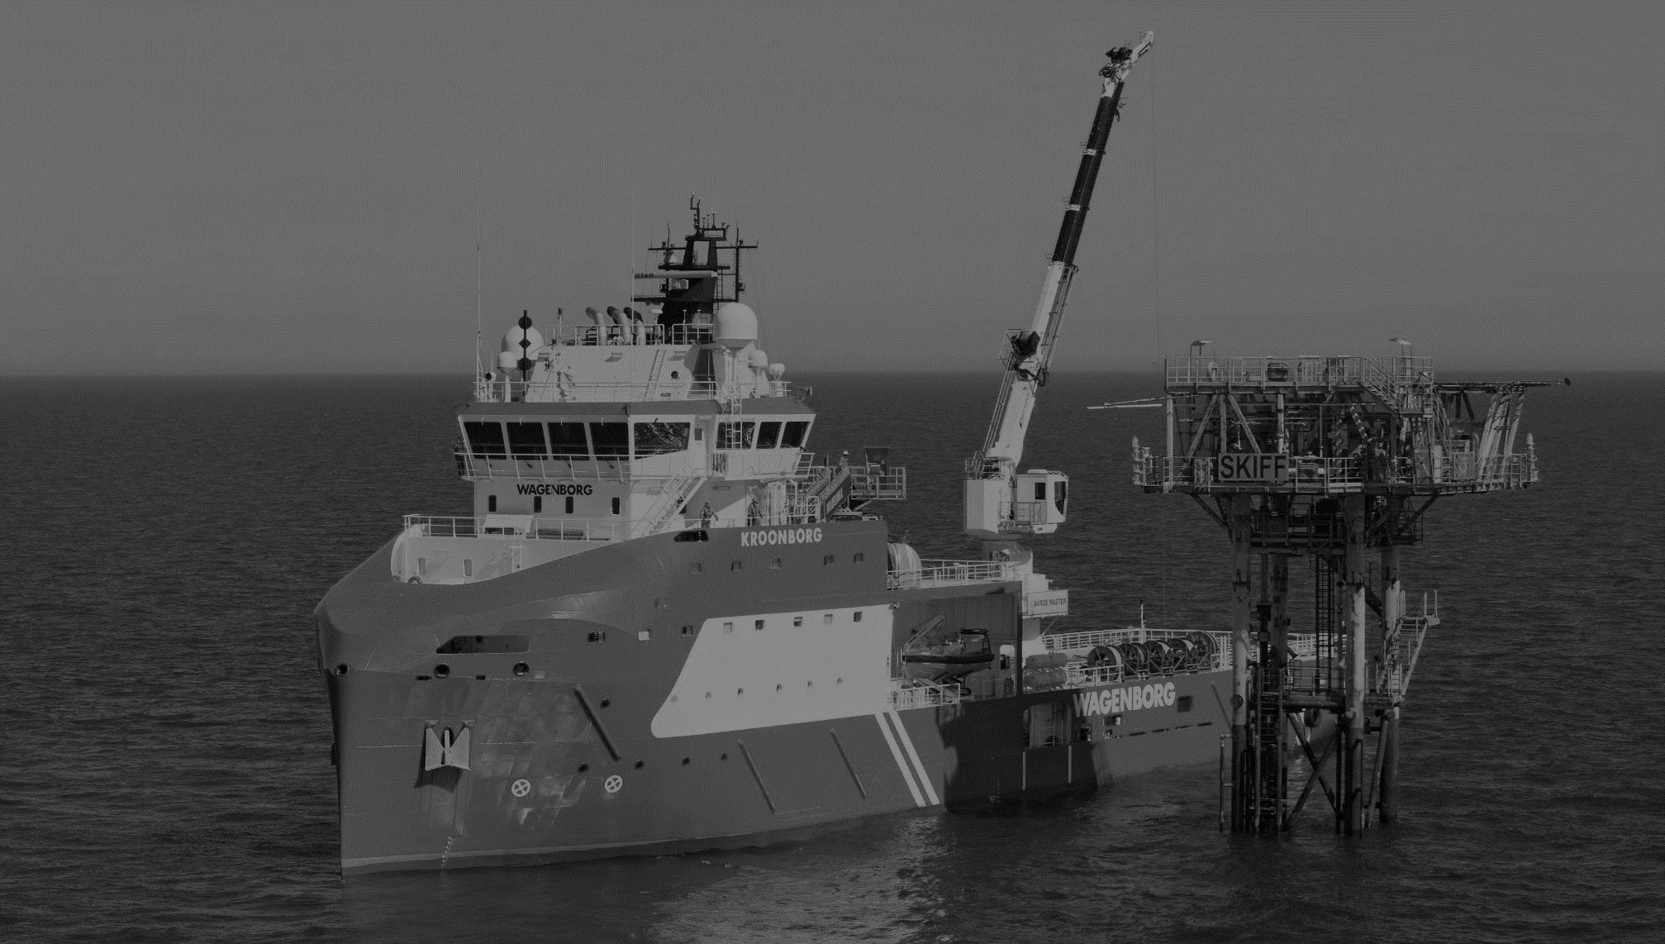
MOTION COMPENSATED CRANE

Slide 11
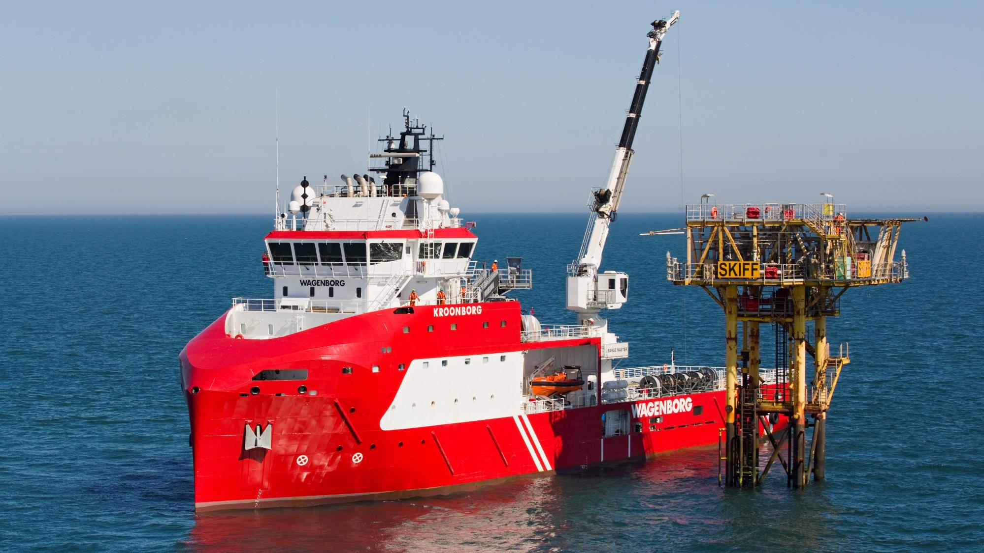
BARGE MASTER SOLUTIONS
MOTION COMPENSATED CRANE

Slide 12
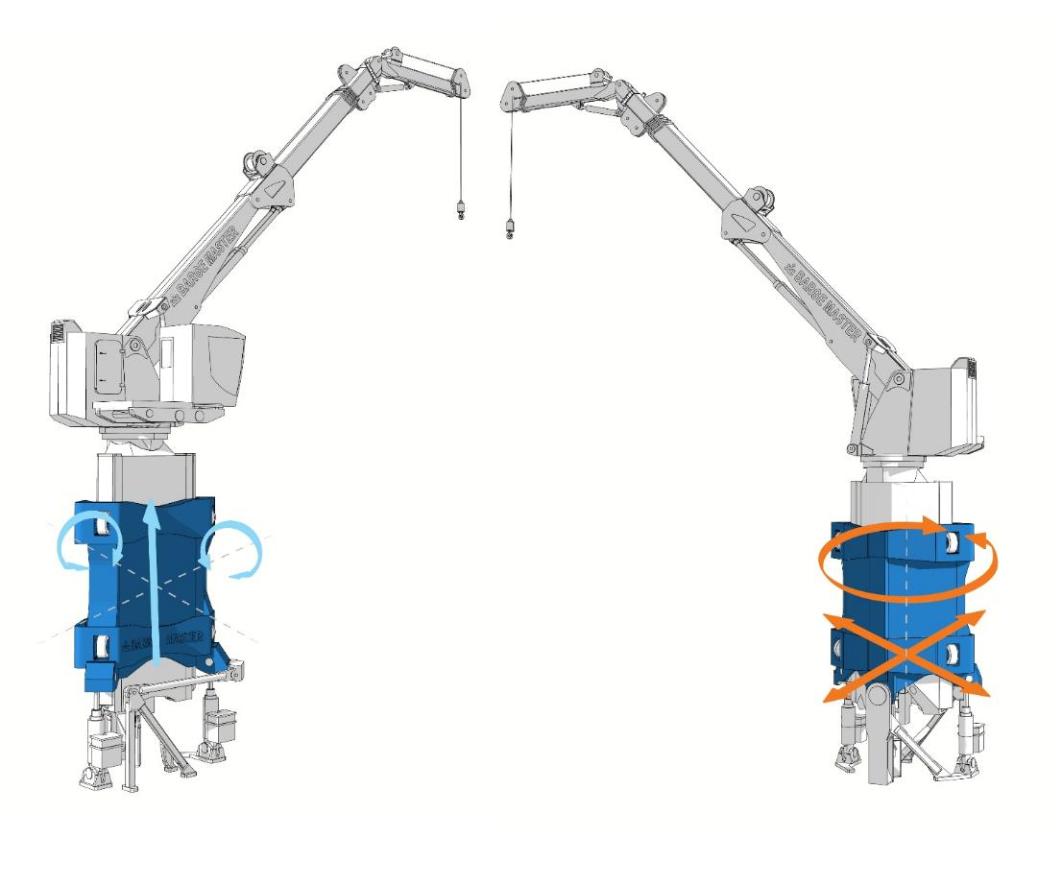
BARGE MASTER SOLUTIONS
MOTION COMPENSATED CRANE
MOTION COMPENSATED CRANE
3 DEGREES OF FREEDOM
Compensation up to Hs 3 m.
Capacity 40 mT
Lloyds register certified
Manriding certified
4.8 m. x 3.7 m. (triangle)
BM-T40 85 mT + Crane 39 mT
Compensation of Heave,
Roll and Pitch motion
Fixation of Surge, Sway and Yaw

Slide 13
BARGE MASTER SOLUTIONS
MOTION COMPENSATED CRANE
CLICK TO PLAY COMPANY MOVIE ON YOUTUBE

Slide 14
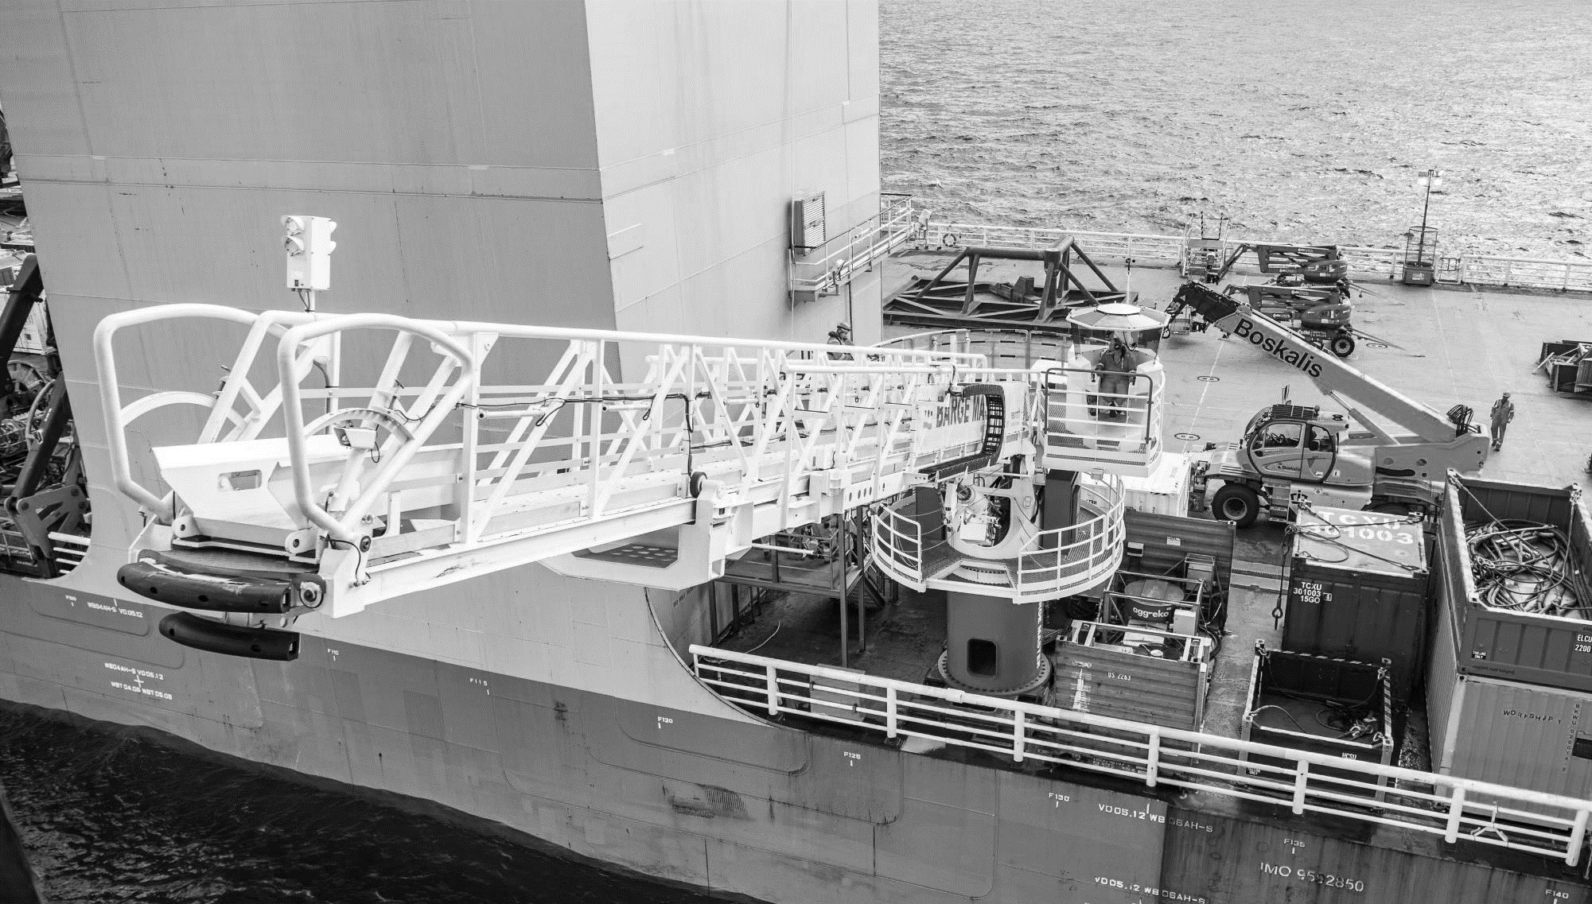
MOTION
COMPENSATED
GANGWAY

Slide 15
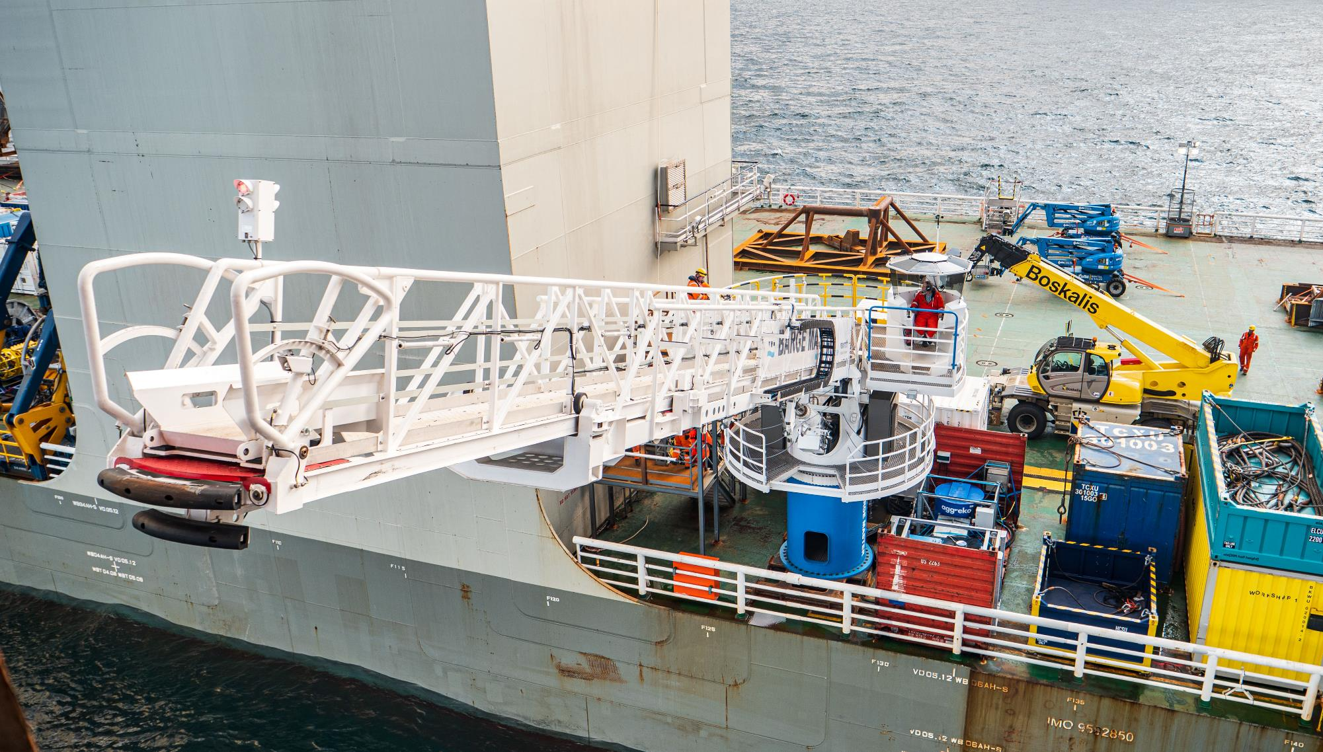
MOTION COMPENSATED GANGWAY
SAFE OFFSHORE ACCESS

Slide 16
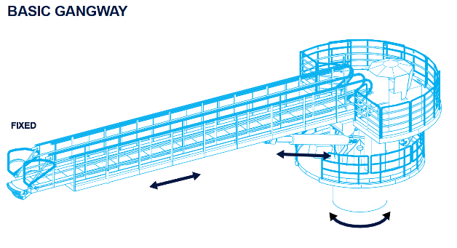
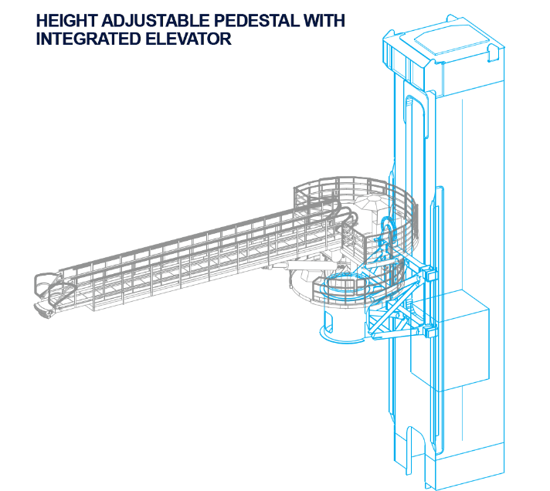


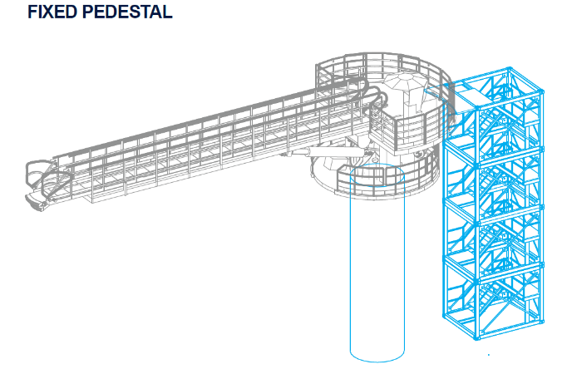
BARGE MASTER SOLUTIONS
MOTION COMPENSATED GANGWAY

Slide 17
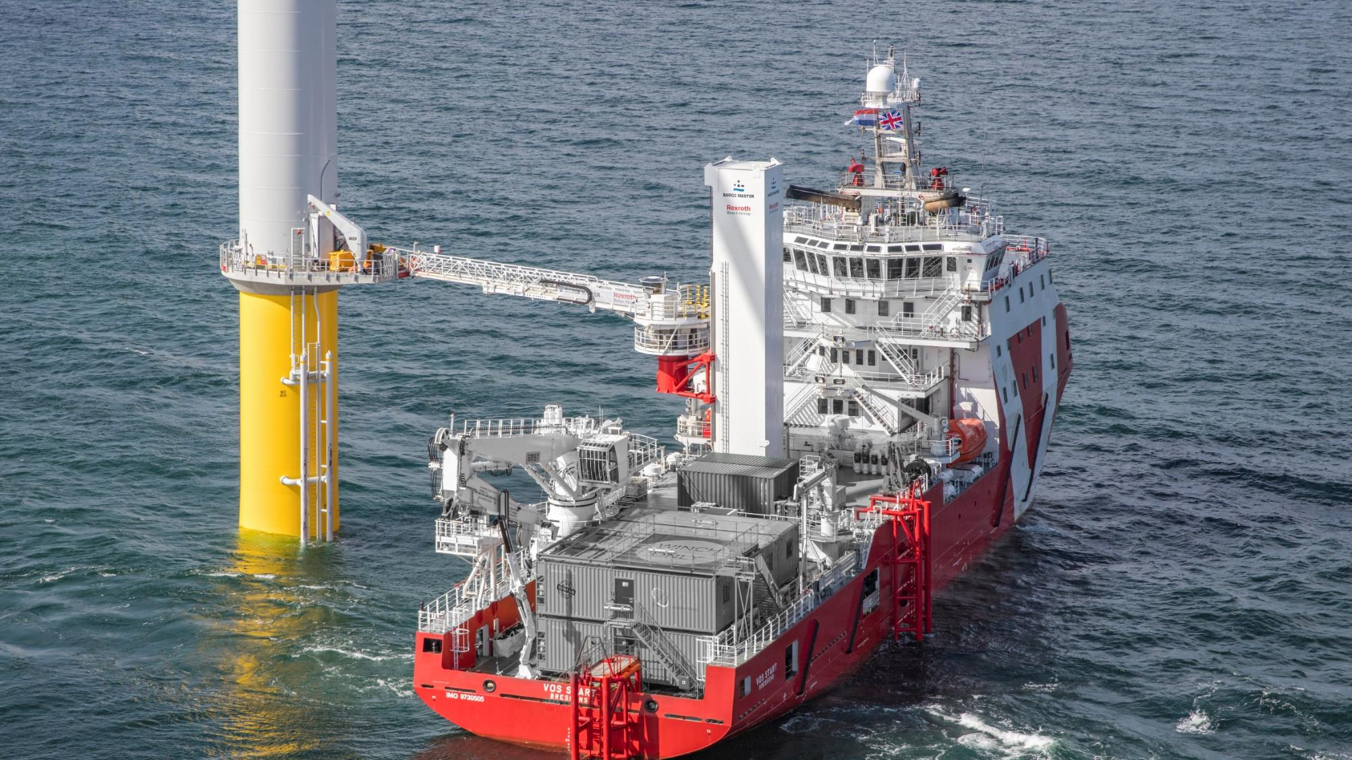
BARGE MASTER SOLUTIONS
MOTION COMPENSATED GANGWAY

Slide 18
BARGE MASTER SOLUTIONS
MOTION COMPENSATED GANGWAY
CLICK TO PLAY COMPANY MOVIE ON YOUTUBE

Slide 19
