Slide 1
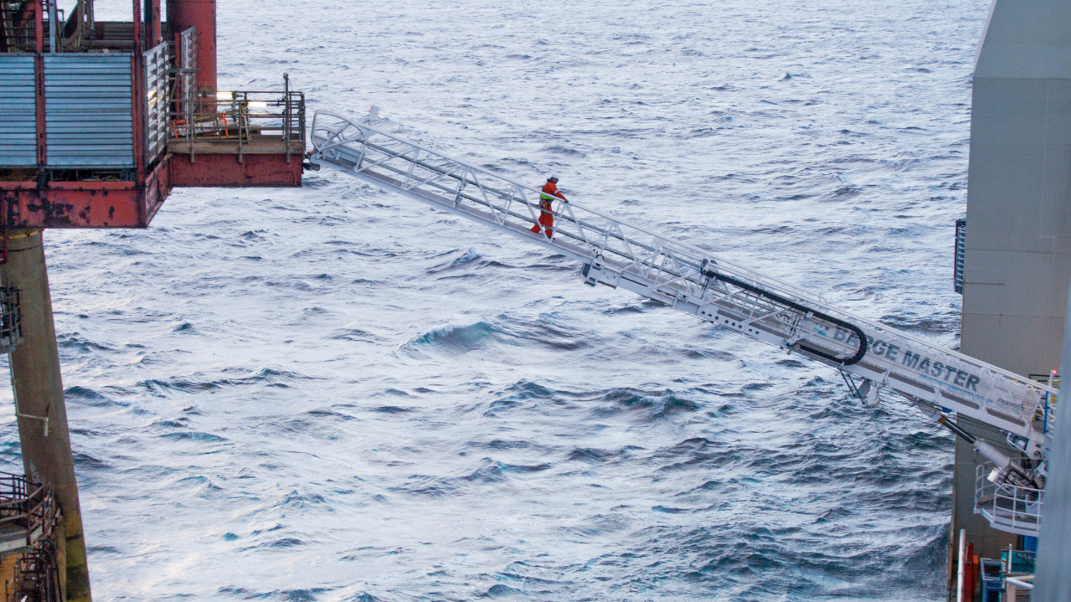
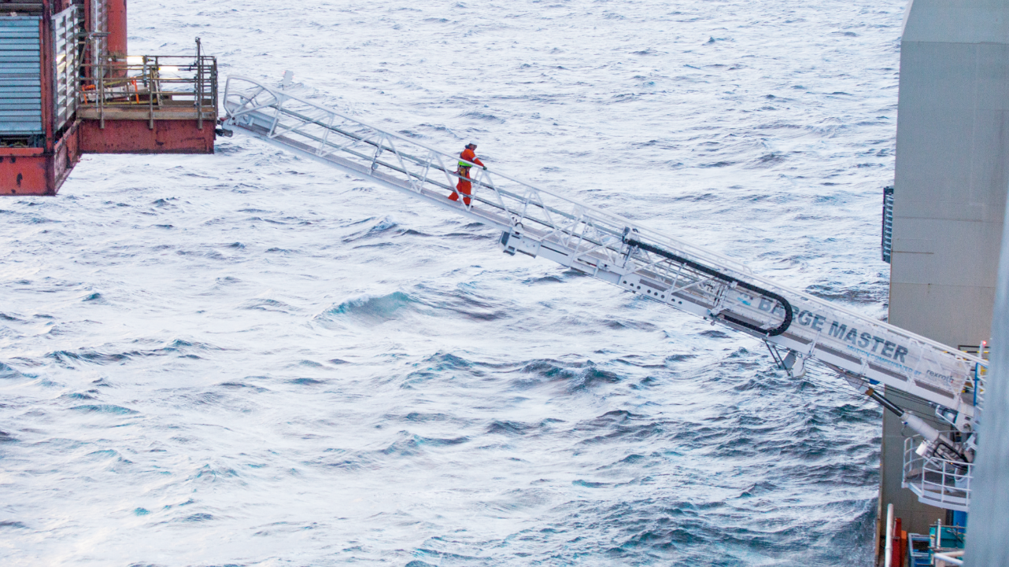
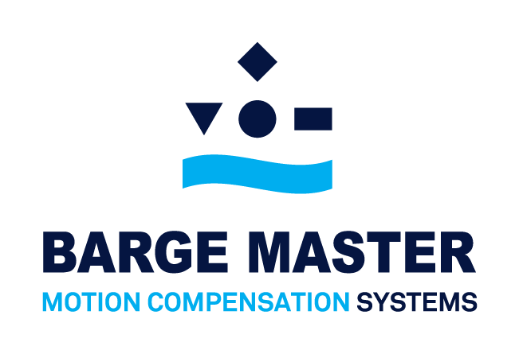
PART 2/2

Slide 2
WELL INTERVENTION
BUSINESS CASE

Slide 3
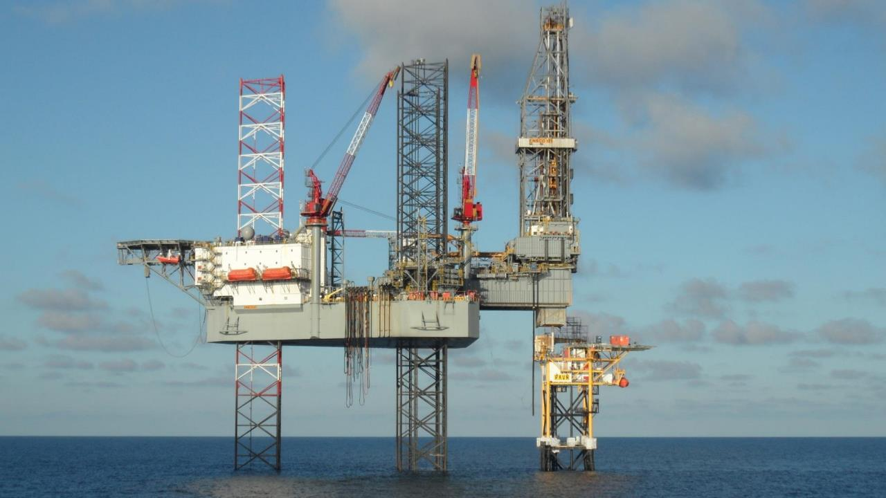

WELL INTERVENTION
CONVENTIONAL METHODS

Slide 4
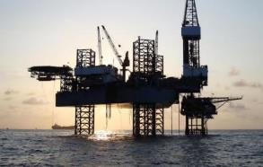
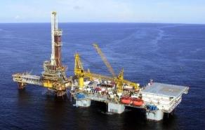
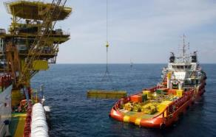
WELL INTERVENTION
CONVENTIONAL METHODS
Jackup rigs with cantilever rig
(semisubmersible) Tender Barges
with offshore crane
These are limited by wave height and cause unsafe working conditions.
Transfer Well Workover equipment onto platform, using platform supply vessel (PSV)
Limited by wave height, deck space, accommodation space and each offshore facility needs its own platform crane.
These are expensive to mobilize, hard to maneuver and limited by water depth and soil conditions/obstructions.
HIGH COST &
LIMITED WORKABILITY

Slide 5
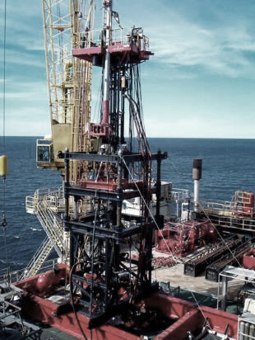
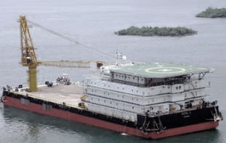
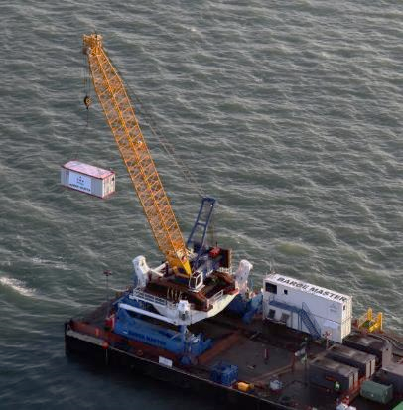
WELL INTERVENTION
BARGE MASTER SOLUTION
+
Hydraulic Workover Unit
Accommodation barge
BM-T700 Motion compensation platform

Slide 6
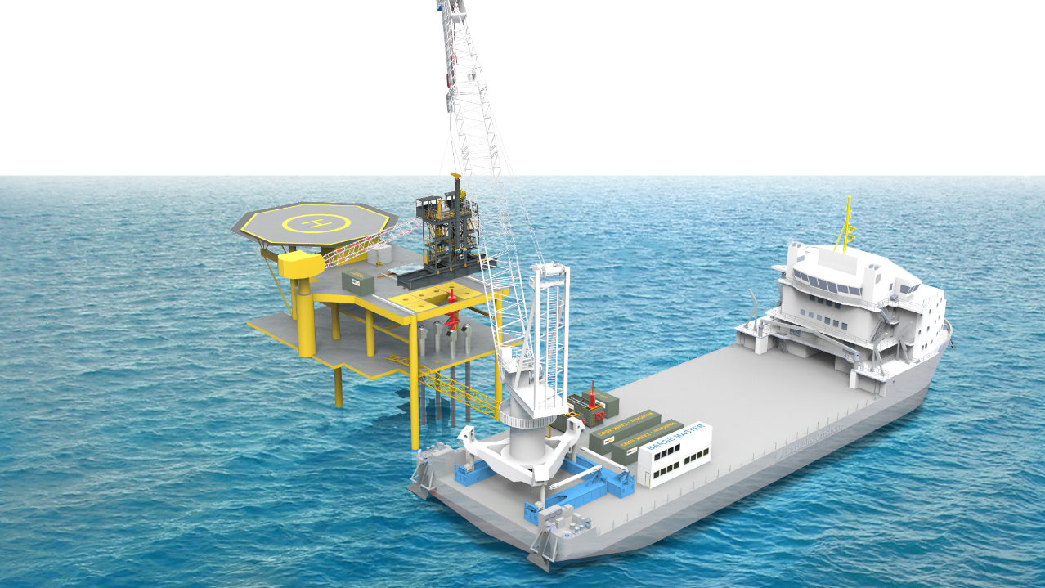
WELL INTERVENTION
BARGE MASTER SOLUTION
Lifting up to 150 ton

Slide 7
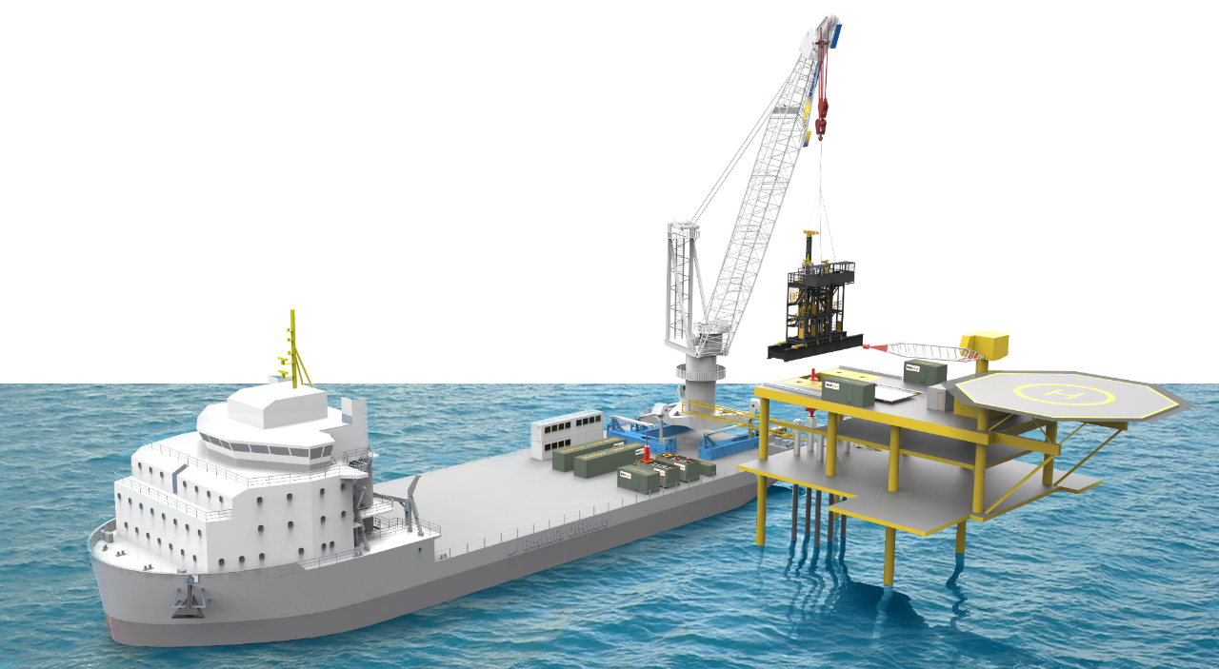
WELL INTERVENTION
SAFE LIFTING OF EQUIPMENT
Low cost system
Unlocking intervention work

Slide 8
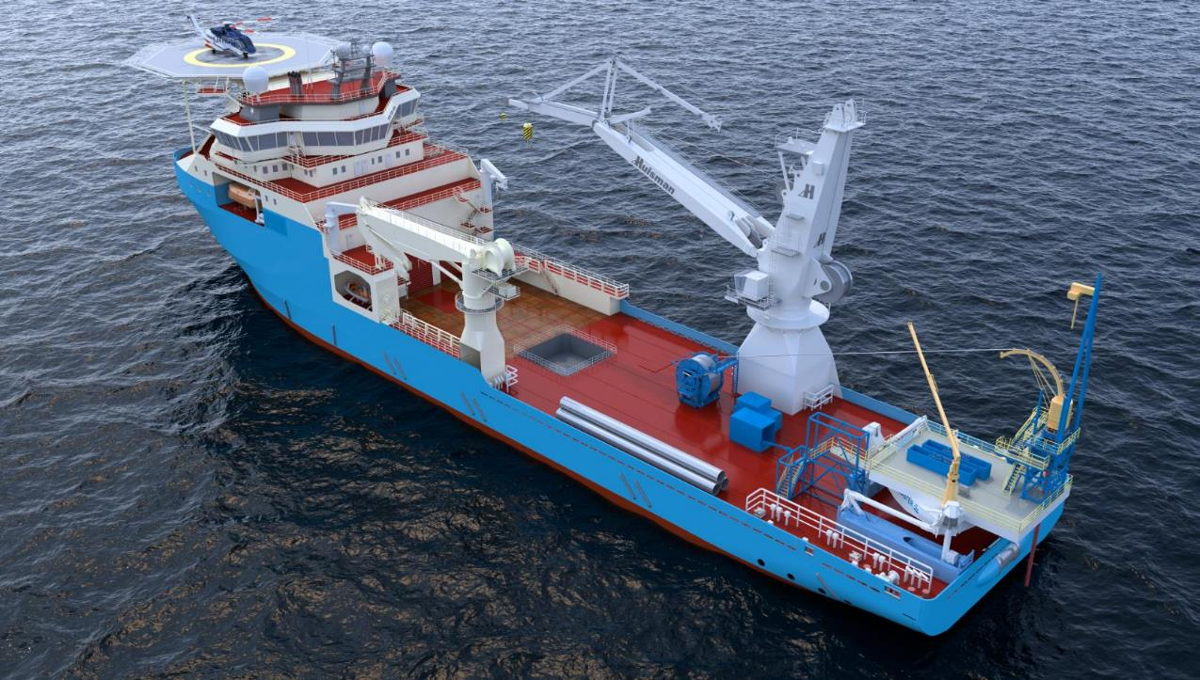
WELL INTERVENTION
COILED TUBING

Slide 9
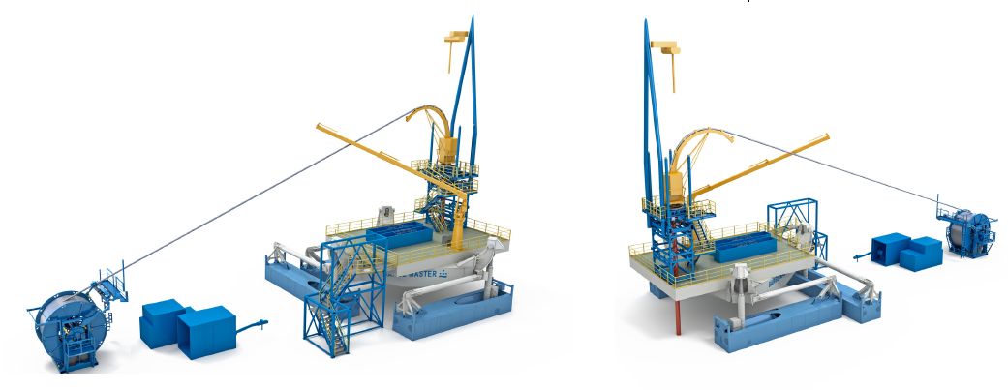
WELL INTERVENTION
COILED TUBING
Payload Capacity: 700mT
Offshore crane capabilities
Working platform 12x12m
Multi purpose:
    Coiled Tubing
    Wireline
    Slickline
    Drilling
    Etc.

Slide 10
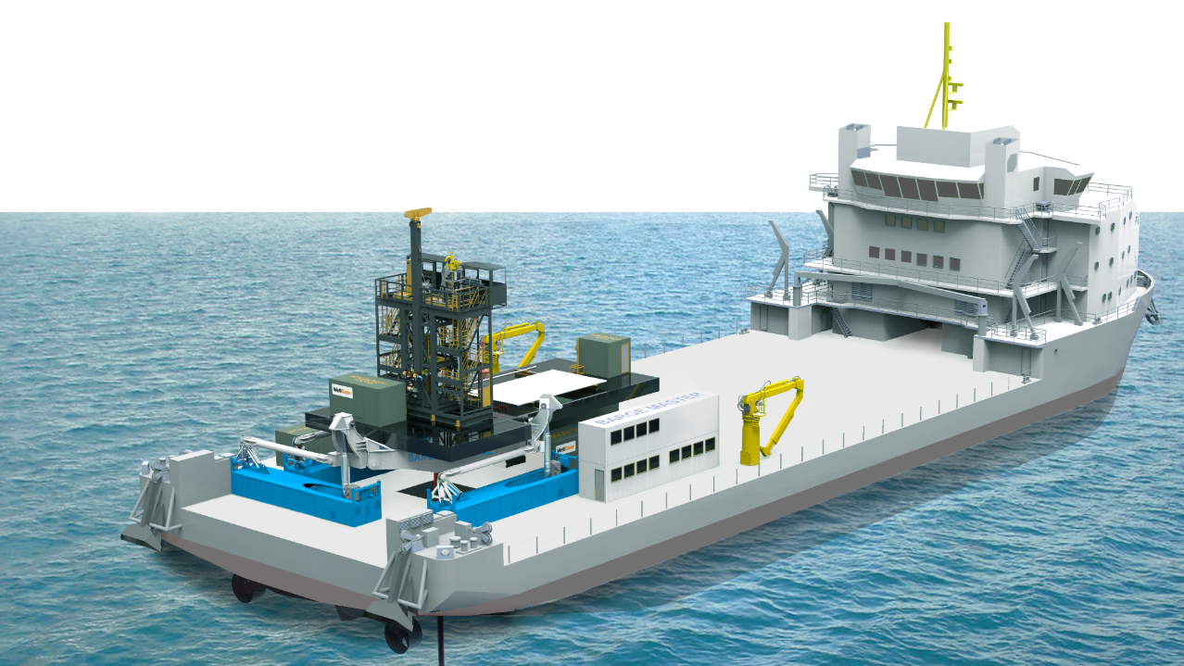
WELL INTERVENTION
BM SOLUTION

Slide 11
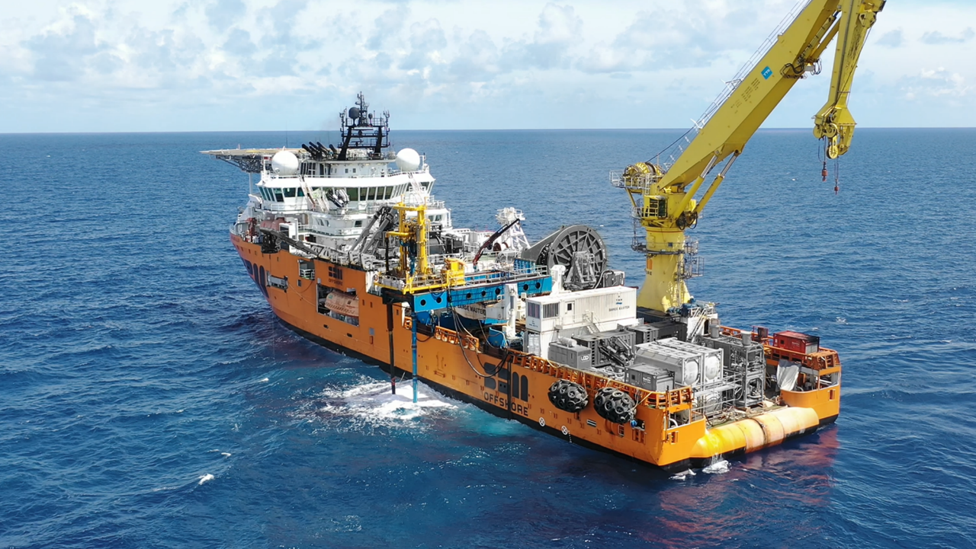
WELL INTERVENTION
PROVEN TECHNOLOGY

Slide 12
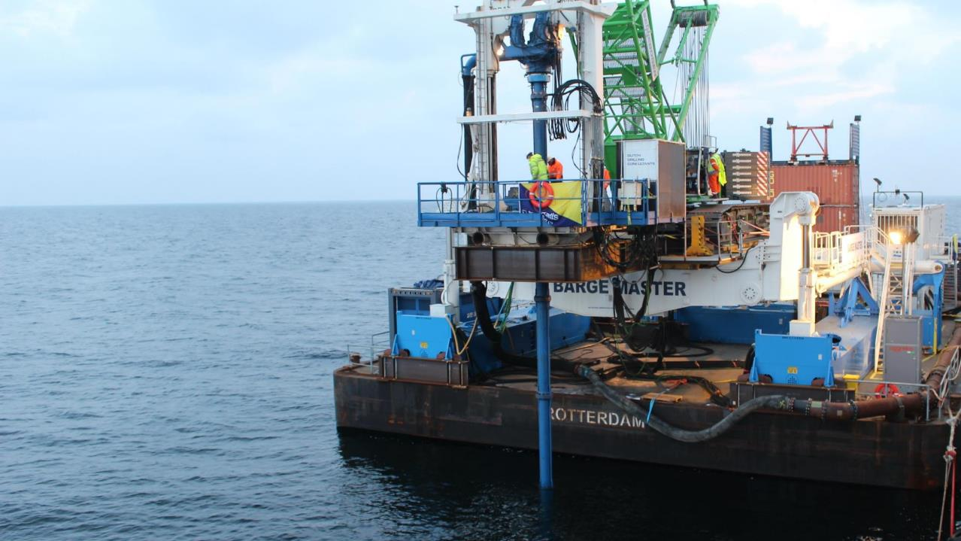
WELL INTERVENTION
PROVEN TECHNOLOGY

Slide 13
CONDUCTOR PIPE REMOVAL
COLLABORATION WITH BOSKALIS AND WELLGEAR

Slide 14
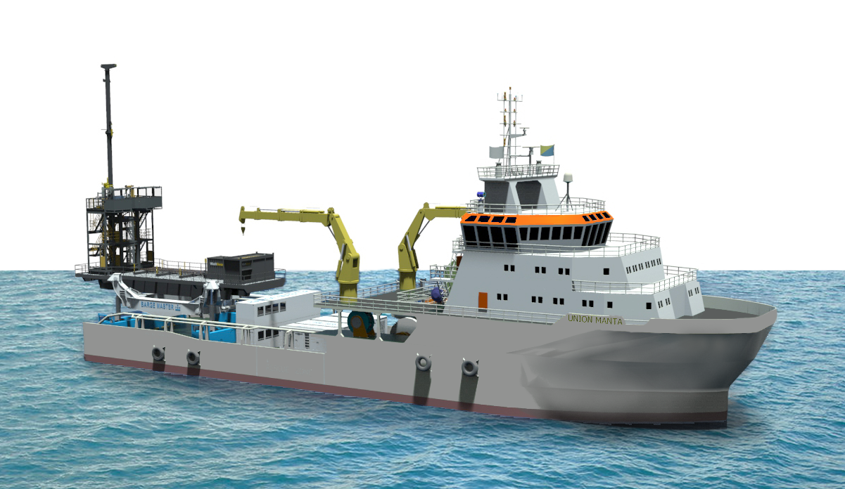
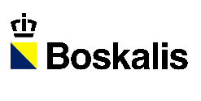

CONDUCTOR PIPE REMOVAL

Slide 15
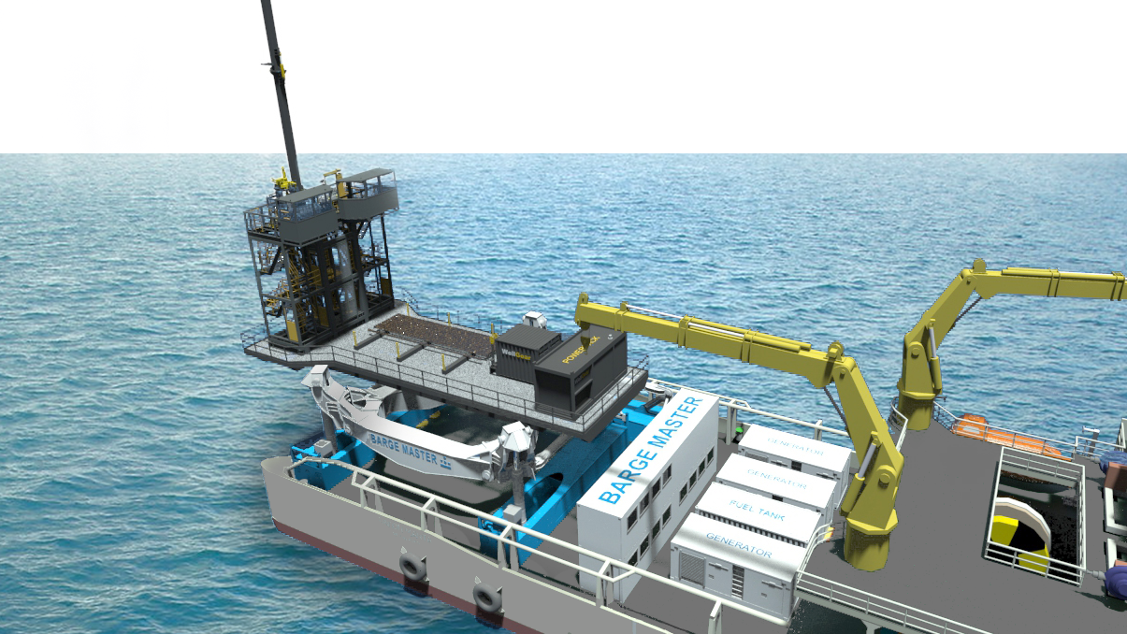
CONDUCTOR PIPE REMOVAL

Slide 16
U.S. WIND FEEDER
COLLABORATION WITH GUSTO MSC

Slide 17
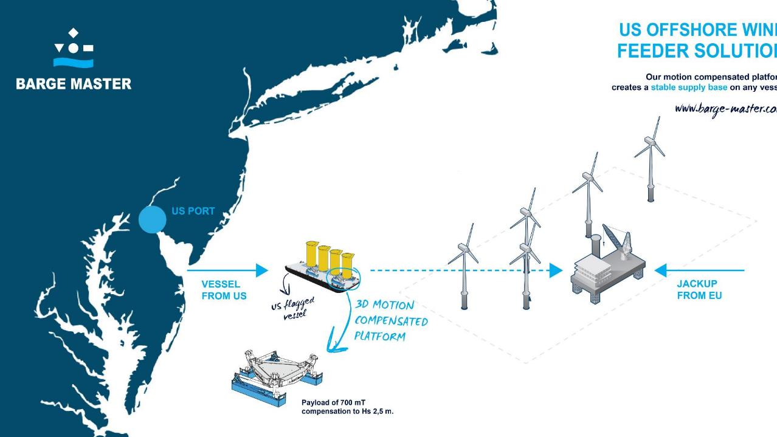

WIND FEEDER SOLUTION
JONES ACT COMPLIENT

Slide 18
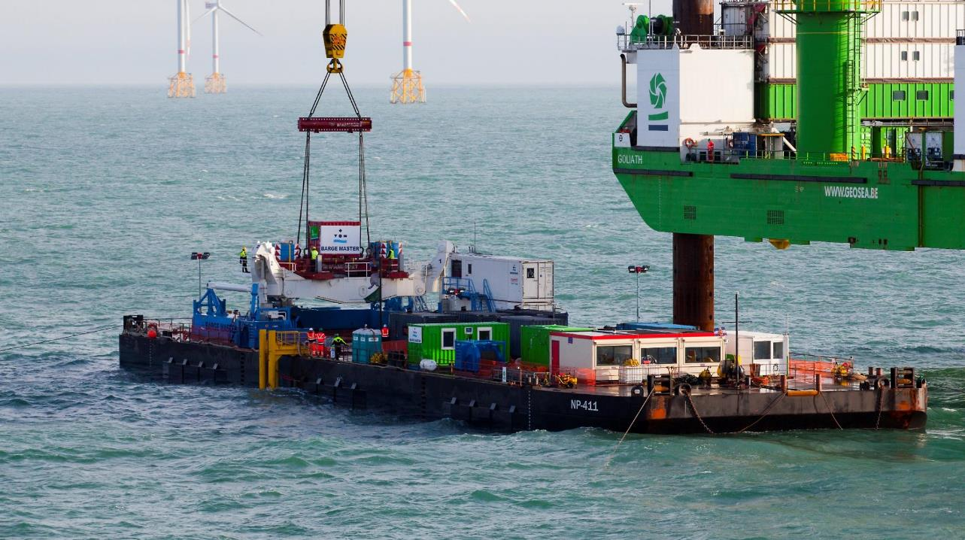
WIND FEEDER SOLUTION
PROVEN TECHNOLOGY

Slide 19
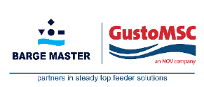
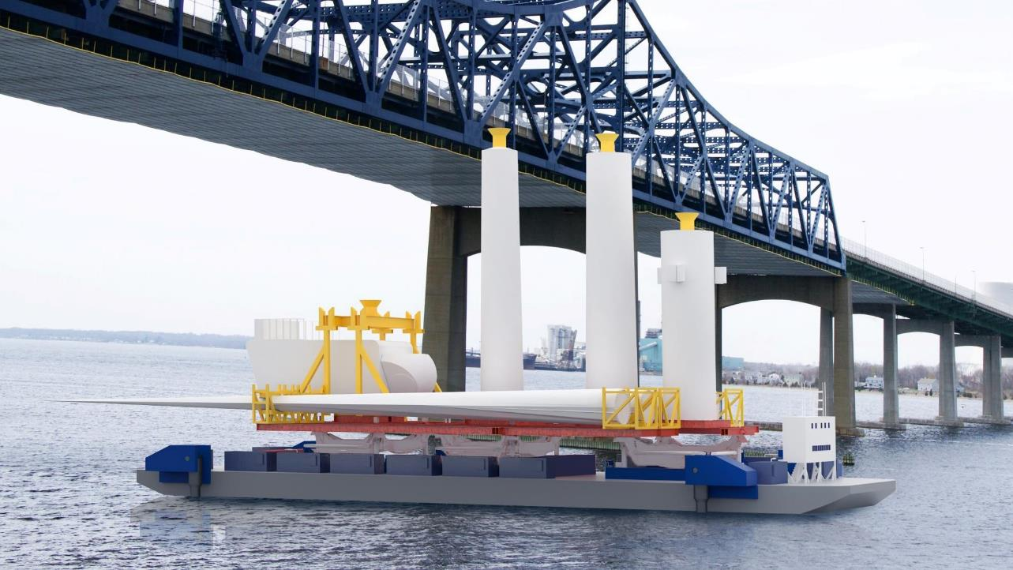
Approval in principle by
LOC

Slide 20
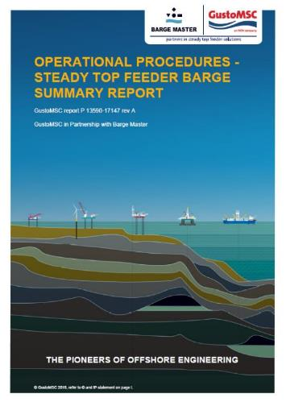
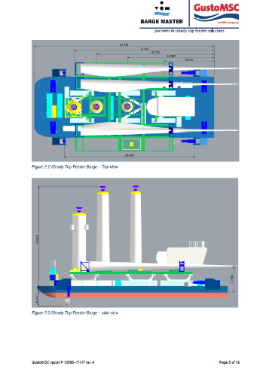
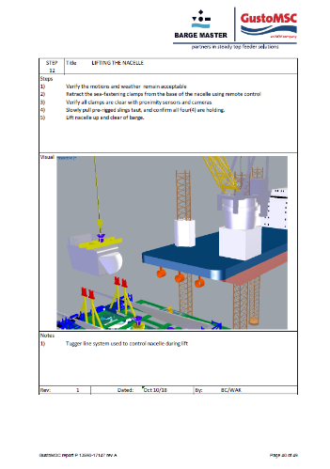
Approval in principle by
LOC

Slide 21
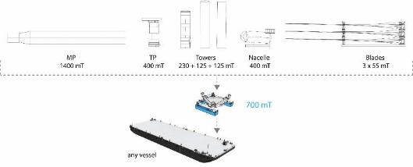
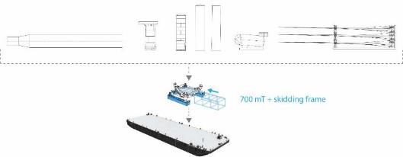
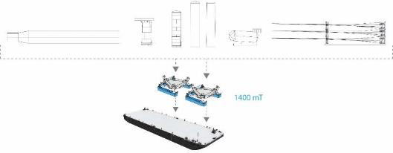
WIND FEEDER SOLUTION
MODULAR SYSTEM
Modular
System
Fit for
purpose

Slide 22
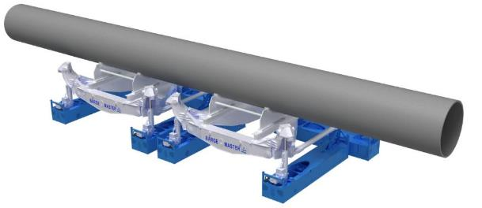
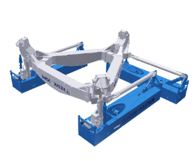
WIND FEEDER SOLUTION
BIGGER SOLUTIONS
+
=
BM-001
700 mT
BM-002
700 mT
BM-T700-TWIN
1400 mT

Slide 23
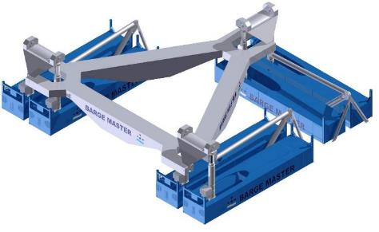
WIND FEEDER SOLUTION
BIGGER SOLUTIONS
+
=
BM-001
700 mT
BM-002
700 mT
BM-T1400
1400 mT

Slide 24
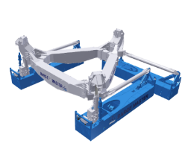

WIND FEEDER SOLUTION
BIGGER SOLUTIONS
700 mT
1400 mT
2100 mT?
2800 mT?

Slide 25
BLADE REPLACEMENT
COLLABORATION WITH TWD

Slide 26
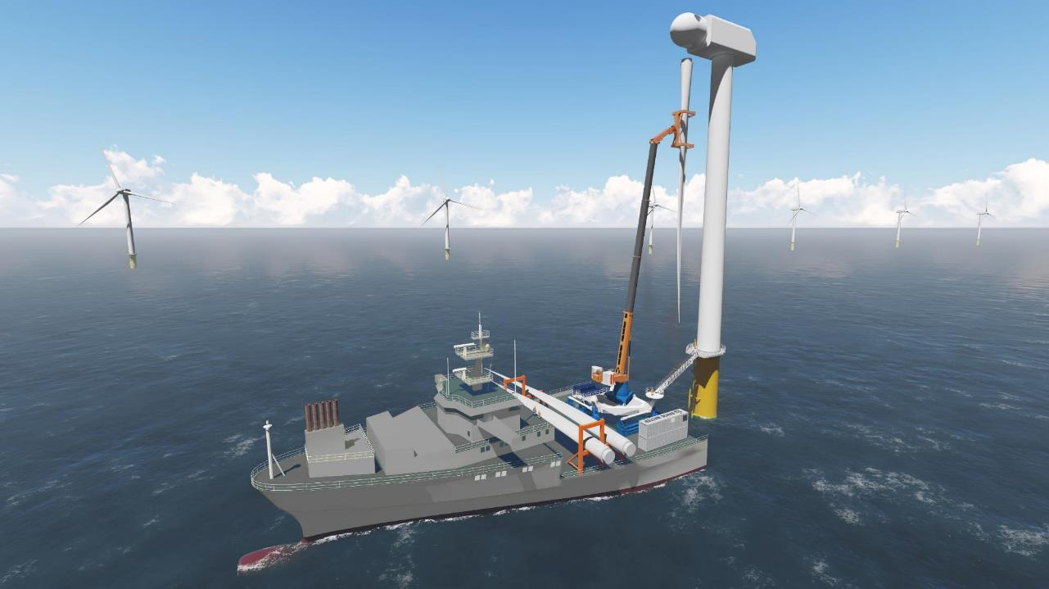

BLADE REPLACEMENT

Slide 27
MOTION COMPENSATED
PILE GRIPPER
COLLABORATION WITH TWD

Slide 28
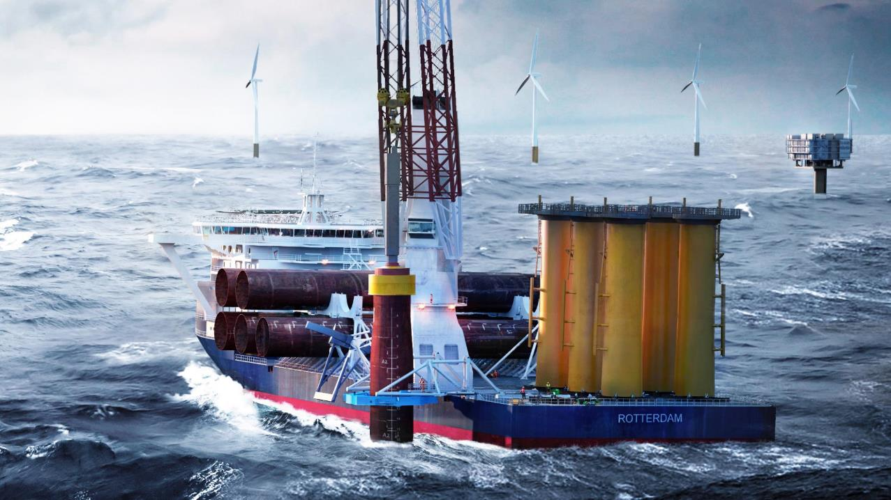
MOTION COMPENSATED GRIPPER

Slide 29
